Slide 1
GERIATRIC TRAUMA
DAN MUSE, MD

Slide 2
EPIDEMIOLOGY
Trauma is the fifth leading cause of death in the elderly population and accounts for up to 25% of all trauma admissions nationally.
Will continue to increase as the population ages.
Mortality increases after age 70 when adjusting for injury severity score.
Pre-hospital geriatric trauma triage criteria improve identification of those needing trauma center care.

Slide 3
GERIATRIC CHANGES
Aging causes physiologic changes that place the elderly at a higher risk of everyday morbidity and mortality
In trauma theses changes make even “minor” trauma “MAJOR”

Slide 4
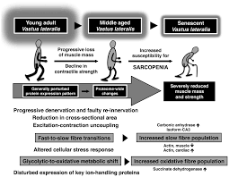
GERIATRICS CHANGES
Geriatric Changes
Mild to severe cognitive impairment
Cardiovascular complications; Pacer, A-fib, Hypertension, CAD.
Pulmonary; COPD
Kidney Disease
Oseoperosis
Loss of muscle mass
Hearing loss
Endocrine: Diabetes, Thyroid disease……. and other organ system insufficiency that can result in general frailty.

Slide 5
GERIATRIC CHANGES
These age-related physiologic changes often limit the geriatric patient’s response to traumatic injury and place them at high risk of complications and death compared to younger counterparts.

Slide 6
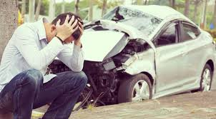
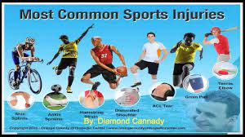
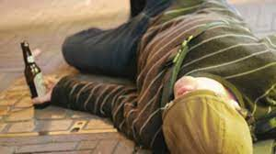
YOUTHFUL TRAUMA
Usually is straight forward
Accidents
Stupidity
Potentially Complicated

Slide 7
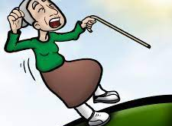
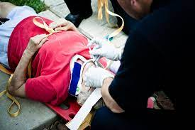
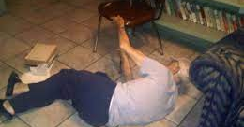
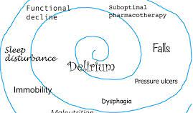
GERIATRIC TRAUMA
MOST ALWAYS COMPLICATED

Slide 8
ETIOLOGY OF GERIATRIC TRAUMA
Falls are the most common mechanism of injury followed by motor vehicle collisions and burns.
It is important to determine if the fall was the result of an isolated mechanical process or a result of a systemic condition that could put the patient at risk for additional falls.

Slide 9
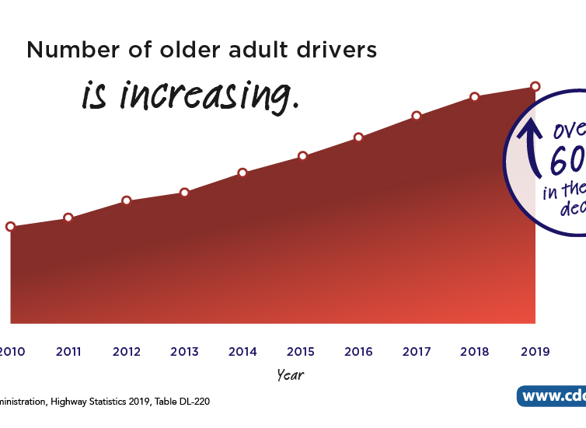
ETIOLOGY
CAUSES:
Falls are the most common
Motor vehicle collisions
Burns.
IN THE ELDERLY YOU MUST DETERMINE IF THE TRAUMA WAS A MECHANICAL PROCESS OR A RESULT OF A SYSTEMIC CONDITION THAT COULD PUT THE PATIENT AT RISK FOR ADDITIONAL FALLS.

Slide 10
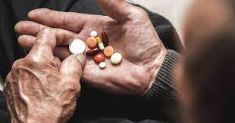
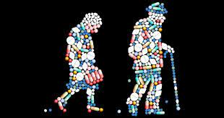
ETIOLOGY OF FALLS
PRECIPITATING CAUSES OF FALLS
Cardiovascular: orthostatic hypotension, dysrhythmia and myocardial infarction.
Infection: urinary, pulmonary or soft tissue sources.
Neurologic disorders: primary or secondary seizures. Parkinson's
The role of polypharmacy and potential disruptions to normal physiologic function cannot be understated.

Slide 11
PATHOPHYSIOLOGY OF GETTING OLD
THE “BABY BOOMERS”ARE BECOMING THE
“DEPENDS GENERATION”

Slide 12
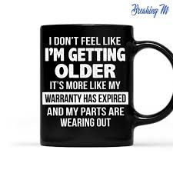
PATHOPHYSIOLOGY
As we age, all our organ systems deteriorate with time and lose their underlying ability to function as they once optimally had at a younger age.

Slide 13
PATHOPHYSIOLOGY
NUTRITION
Poor protein or total caloric intake
Mineral and supplement deficiencies.
Nutritional deficiencies significantly effect
Healing
Result in immune suppression impacting the ability to fight off infection.
Makes them more susceptible to more morbidity and higher risk of mortality.
Elderly may have various degrees of malnutrition

Slide 14
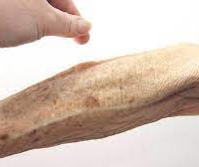
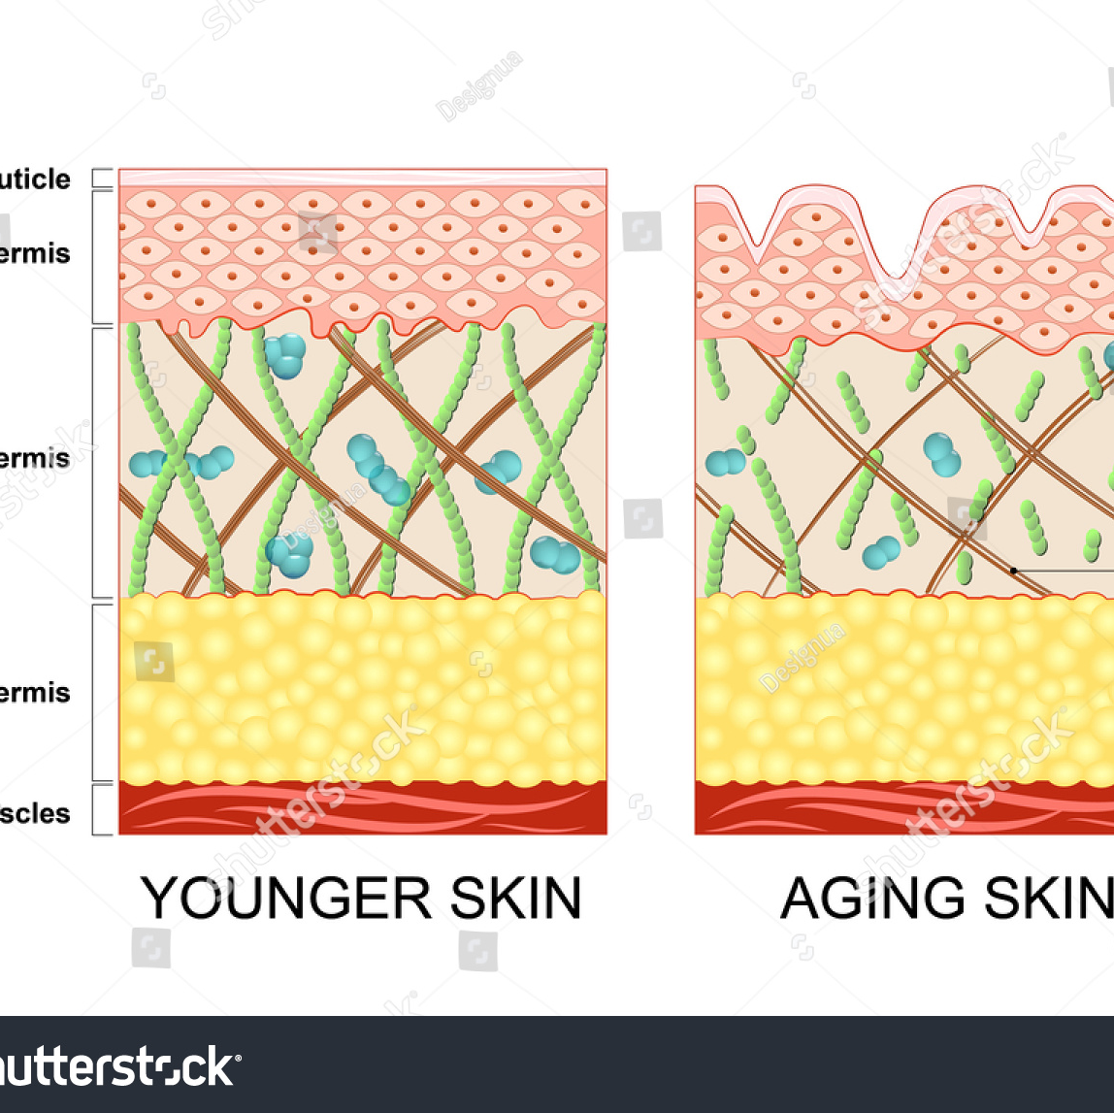
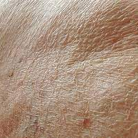
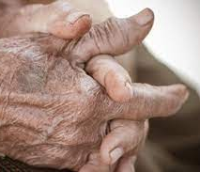
PATHOPHYSIOLOGY
Integument/Musculoskeletal
Elderly patients have a decrease in
Lean body mass,
Thinning of the skin
Overall increase in total body fat.
Thin skin means loss of thermoregulation
Become more susceptible to hypothermia even when in warm weather.

Slide 15
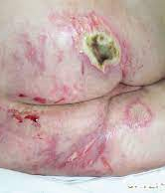
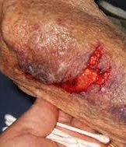
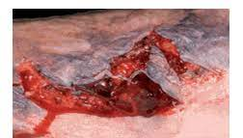
PATHOPHYSIOLOGY
Integument/Musculoskeletal
Loss of skin elasticity makes it more susceptible to skin tears and avulsions even with minor energy transfer.

Slide 16
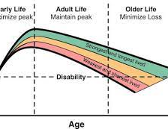
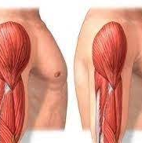
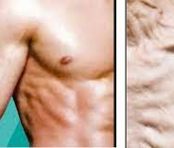
PATHOPHYSIOLOGY
Integument/Musculoskeletal
Loss of lean muscle mass and overall bone density via demineralization processes such as osteopenia and osteoporosis lead to less strength, loss of locomotion, balance, and ability to produce heat through shivering.

Slide 17
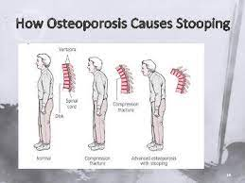
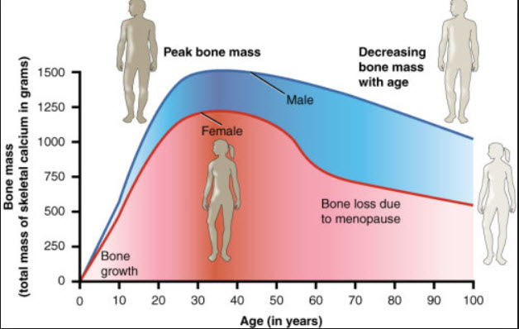
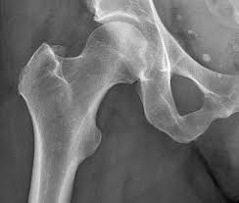
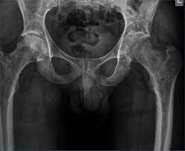
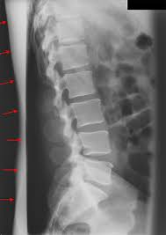
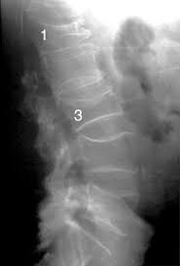
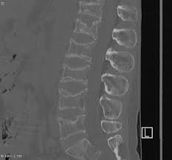
PATHOPHYSIOLOGY
Integument/Musculoskeletal
Loss of bone density leads to a higher risk of fracture with a lower energy transfer associated with more minor injury mechanisms.

Slide 18
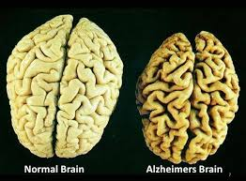
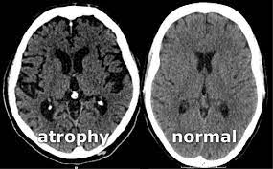
PATHOPHYSIOLOGY
Neurologic
NEUROHUMORAL RESPONSES in the elderly patient are often blunted leading to a slower and often less vigorous response to stimuli.
Neurocognitive decline Dementia, Strokes
Co-morbidities such as diabetes can lead to peripheral neuropathy
STRUCTURAL CHANGES
Normal parenchymal atrophy
Decreased ability to auto-regulate cerebral blood flow and underlying atherosclerotic cerebrovascular disease.

Slide 19
PATHOPHYSIOLOGY
Neurologic
AND WE ARE KILLING THEM WITH OVER MEDICATING.
Can lead to drowsiness,
Loss of energy,
Oversedation,
Loss of balance and memory

Slide 20
PATHOPHYSIOLOGY
Cardiovascular
In trauma we need the ability to increase our cardiac output to compensate for loss of blood.
cardiac output = heart rate X stroke volume
Cardiac conduction system becomes more fibrotic
This all leads to a decreased ability to adjust the heart rate. Also…..
Drugs: amiodarone, metoprolol, diltiazem
Pacermaker
The aging heart becomes stiffer
Is less compliant; can’t stretch and contract losing the ability of increasing volume and contracting harder. Can’t adjust stroke volume.

Slide 21
https://www.youtube.com/watch?v=vFRkSB46bl8

Slide 22
PATHOPHYSIOLOGY
Cardiovascular
Elderly suffer from relative mild hypovolemia.
Poor intake with associated dehydration
Baseline anemia
Have greater impact on pre-load (the blood available to push out of the ventricle) and overall lower cardiac output.
Elderly have less ability to contract their vessels (systemic vascular resistance)
Arterial side: hinders increasing blood pressure.
Venous side: Blood pools and doesn’t return efficiently to the heart.

Slide 23
PATHOPHYSIOLOGY
Pulmonary
Overall pulmonary function is found to deteriorate in older adults.
Diminished respiratory reserve.
Limited ability to adapt compensatory physiologic processes to hypoxia, hypercarbia and correct metabolic disturbances such as acidosis is blunted.
Loss of their lean muscle mass, and elasticity resulting in early fatigue

Slide 24
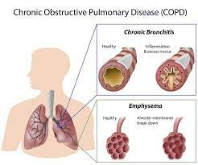
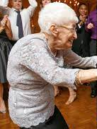
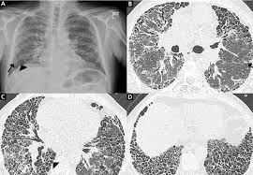
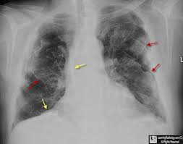
PATHOPHYSIOLOGY
COPD
Pulmonary
FIBROSIS
ASBESTOSIS
KYPHOSIS

Slide 25
PHYSIOLOGIC CHANGES IN THE ELDERLY
Organ system | Changes | Implications
Pulmonary | Decreased vital capacity Decreased forced expiratory volume Smaller alveolar surface area Decreased chest wall compliance | Reduced respiratory reserve
Cardiac | Decreased cardiac output Decreased sensitivity to catecholamines | Reduced cardiac reserve Vital signs may not reflect severity of injury
Renal | Decreased glomerular filtration rate Decreased renal mass | Increased risk of traumatic injury Increased risk of contrast-induced nephropathy Increased susceptibility to fluid overload Reduced clearance of certain medications
Hepatic | Decreased hepatic function | Decreased clearance of certain medications
Gastrointestinal | Diminished pain sensation Increased laxity of abdominal wall musculature | Potential for significant abdominal injury without peritoneal signs
Immune | Impaired immune response | Increased risk of infection
Musculoskeletal | Loss of muscle mass Osteoporosis | Increased risk of fracture
Neurologic | Decreased autoregulatory capability Brain atrophy | Increased susceptibility to injury from decreased cerebral perfusion Increased risk for occult injury

Slide 26
GERIATRIC TRAUMA
MOST ALWAYS COMPLICATED
Geriatric trauma patients are more likely than younger adults to have prolonged prehospital scene time. This disparity may be caused by delayed recognition of injury severity or age-related cognitive biases.
https://www.americanjournalofsurgery.com/article/S0002-9610(21)00624-3/fulltext

Slide 27
TRAUMA TRIAGE
Weighted 1-year mortality rates increased from 6.9% for trauma patients aged 18--54 years to 32.2% for patients aged 75--84 years (Table 7).
A 13-year review of a state trauma database, indicated that every 1-year increase in age after age 65 years corresponded to a 6.8% increase in mortality (110).
A case-control study indicated that older trauma victims who died from their injuries had a lower ISS than younger victims who died (11
https://www.cdc.gov/mmwr/preview/mmwrhtml/rr5801a1.htm3)

Slide 28
TRAUMA TRIAGE
Pennsylvania study indicated that patients aged >65 years with ISS of >15 were less likely to be treated in a trauma center than patients aged <65 years with ISS of >15 (36.6% and 47.0%, respectively), even though those treated at nontrauma centers had a high ISS (mean: 19.3), leading the authors to conclude that the ability of EMS and nontrauma center personnel to recognize severe injury among the geriatric population is substantially lower than that among younger patients (114). A
https://www.cdc.gov/mmwr/preview/mmwrhtml/rr5801a1.htm3)

Slide 29
TRAUMA TRIAGE
A retrospective analysis of injury-related admissions to Portland, Oregon--area hospitals indicated that 56% of trauma patients aged >65 years with ISS of >15 were admitted to nontrauma-center hospitals, compared with 15% of severely injured patients aged <65 years (115). These disparities are likely attributable, at least in part, to the inadequacy of anatomic, physiologic, and mechanism-of-injury triage criteria for elderly trauma victims.
https://www.cdc.gov/mmwr/preview/mmwrhtml/rr5801a1.htm3)

Slide 30
HISTORY AND PHYSICIAL
NEED A HISTORY THAT ACCOUNTS FOR
How the trauma occurred:
Mechanical,
Sob,
Dizzy,
Chest pain……
Comorbid conditions.
Diabetes
COPD
CAD
Immunocompromised……
AND KNOWING THE PATIENT’S BASELINE MENTAL STATUS IS IMPERATIVE!

Slide 31
HISTORY AND PHYSICIAL
VITAL SIGNS
Often vital signs appear normal until the patient deteriorates rapidly.
Blood pressure and pulse may mislead due to physiologic changes with aging
Vitals may be altered by polypharmacy.
Cardiovascular: Beta blockers, calcium channel blockers, amiodarone….
Psychiatric: Prozac, Seroquel, respiradol….
Anticholinergic: Ditropan, Atarax, meclizine Benadryl
Schedule 2’s: Opioids, benzodiazepines

Slide 32
HISTORY AND PHYSICAL
CARDIOVASCULAR/SHOCK
Defined as global tissue hypoperfusion.
Clinically defined as a systolic blood pressure less than 90 mmHg.
Current literature supports a systolic blood pressure of 110 mmHg in patients over 65 to be a better benchmark for occult trauma.

Slide 33
HISTORY AND PHYSICAL
CARDIOVASCULAR/SHOCK INDEX:
The utilization of the shock index has been found to be a more sensitive indicator.
It is calculated as the quotient of the systolic blood pressure by the heart rate (shock index = heart rate/systolic blood pressure).
A shock index of 0.5-0.7 is considered normal
When it exceeds 0.7, the patient is in shock.

Slide 34
HISTORY AND PHYSICAL
CARDIOVASCULAR/ RASI
RASI: Respiratory adjusted shock index
RASI felt to be more sensitive such as the Shock Index
RASI is calculated by multiplying the shock index by (respiratory rate/10).
When the RASI is greater than 1.3, it suggests that the patient is in occult shock.

Slide 35
HISTORY AND PHYSICIAL
AND NOW THE PHYSICAL
Full evaluation must be performed and not limited to the complaint
Elderly tend to downplay injuries.
Have delays in recognition of injuries
Comorbid issues may blunt their ability to perceive injuries
Neuropathy
Medications
Dementia
Difficulty localizing pain

Slide 36
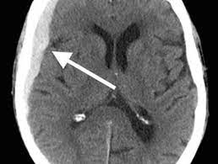
EVALUATION
HEAD INJURIES
CEREBRAL ATROPHY: BRAIN SHRINKS AS YOU AGE.
Dura veins fix to skull causing shearing injuries
Atrophy allows for bleeding without neurologic symptoms while the head fills with blood
Patients are on blood thinners

Slide 37
https://www.youtube.com/watch?v=64fcupSbbgs

Slide 38
CASE #1
“To refuse or to cancel, that is the question”

Slide 39
EMS
99 Y/O male with cc of hyperglycemia, Found sitting on couch.
Blood Sugar: 595. Responding only to painful stimuli
On Lantus and son states he took it in the morning
Next to patient are what looked like parts of multiple cornbread muffins

Slide 40
EMS
VS: BP: 231/104 PULSE: 68 RESP: 30 “rapid & regular”. 98% RA
IV & EKG done
No GCS

Slide 41
BROCKTON HOSPITAL
99 y/o male seen earlier in the day after missing the seat when going to sit down and landing on buttocks. Neighbor call 911. Patient noted to be alert and oriented x 3 and refused transport.
Later in the day, son came to check on his father and found him unresponsive.
Ambulance called and transported to the hospital.

Slide 42
BROCKTON HOSPITAL
VS: TEMP: 99.1 BP: 181/87 PULSE: 87 RESP: 22 O2: 99% 2 LTS
General
Limitations: altered mental status
General appearance: obtunded and other (Patient is noted to have large amounts of food products in his mouth which are being suctioned out. Unresponsive.)
Head exam: atraumatic and normocephalic
Eye exam: Present other (Reactive right slightly larger than the left.);
ENT exam: other (Food product in the posterior pharynx which is being suctioned.)
Neck exam: Present normal inspection, trachea midline and other (Collar is being applied with a history of a fall)

Slide 43
BROCKTON HOSPITAL
Chest inspection: Present normal inspection and symmetric chest wall rise
Respiratory exam: Present normal lung sounds bilaterally; Absent respiratory distress
Cardiovascular exam: Present regular rate, normal rhythm and normal heart sounds; Absent systolic murmur
Abdominal exam: Present soft; Absent distention, tenderness, guarding and rebound
Neurological exam: Present other (Patient's eyes are Closed. Does not respond to the significant pain except the groan. Overall, no significant motor movement is noted. Is not responding to voice)

Slide 44
BROCKTON HOSPITAL
DIFFERENTIAL DIAGNOSIS AMS

Slide 45
BROCKTON HOSPITAL

Slide 46
BROCKTON HOSPITAL
Sent for CT Scans of whole body.
On way back had short seizure and RN/FF/Paramedic caring for him felt he started to posture.
Also thought pupils now with right side larger.

Slide 47
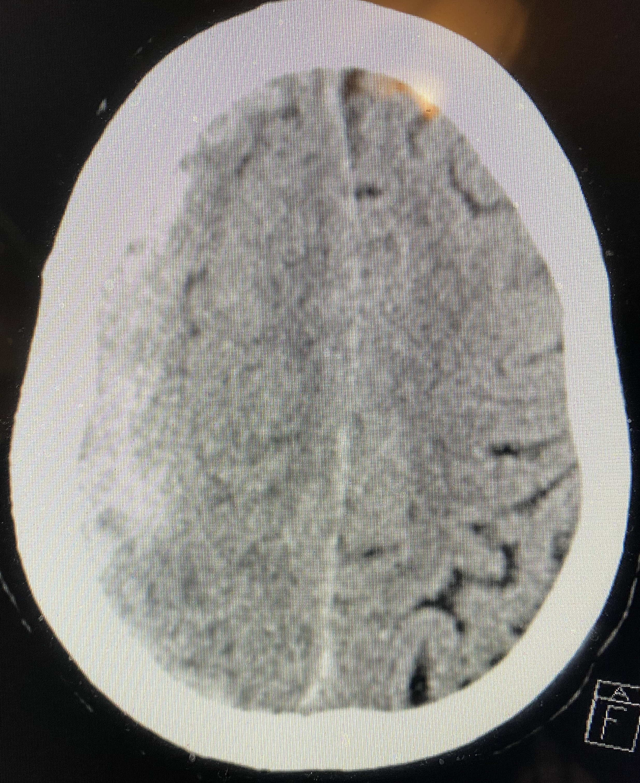
BROCKTON HOSPITAL

Slide 48
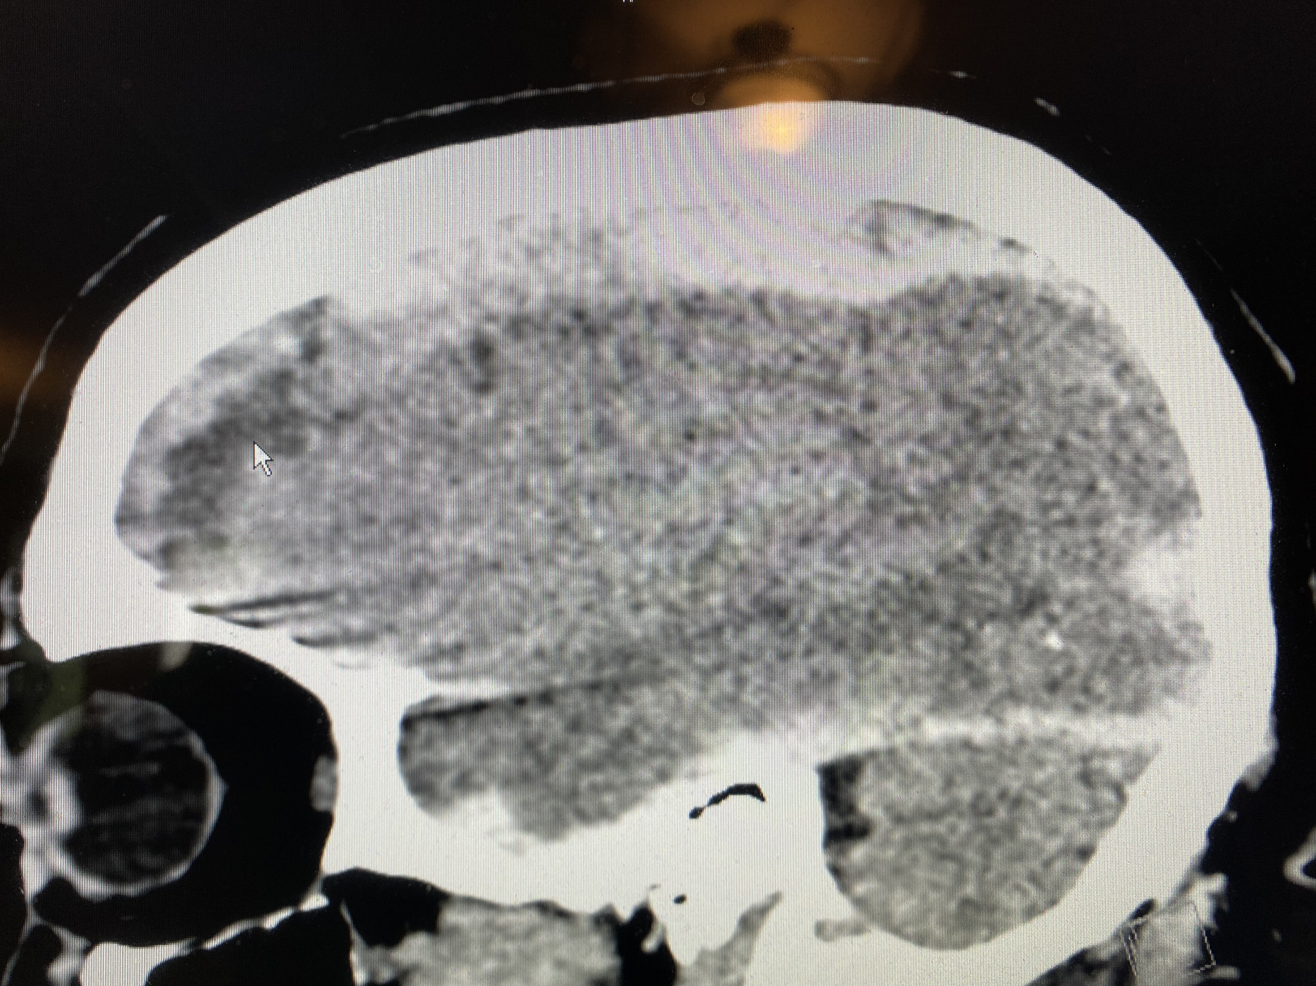
BROCKTON HOSPITAL

Slide 49
BROCKTON HOSPITAL
Not a mark on the patient. Absolutely no trauma so what happened?
Coup Counter Coup
Fell later
Von Willebrand’s!

Slide 50
EPILOGUE
Had been seen earlier in the day.
Missed seat and fell on porch floor
Neighbor interpreted for patient. Minimal English
CALL CANCELLED

Slide 51
CASE #2: AMBULANCE

Slide 52
CASE #2: AMBULANCE

Slide 53
CASE #2 BROCKTON HOSPITAL
HPI Narrative: 75 yo w pmh dvt on coumadin presents w report of fall and AMS. history per wife. Last night he woke at 2 am w report of Headache, She gave him ibuprofen , She heard him wake at 530 and then she heard him fall, She found him on his back with his head against the bathtub. HE has been drowsy since the fall per wife. She says hes been off all week. He has been sleeping more and weak all over and when walking aorund the house hes been grabbing onto the wall. He fell on xmas eve but did not hit his head. no fever cough sob abd pain n, v d no dysuria urgency She states he has been limping on his left leg for few weeks now ,she wasnt sure if he hurt his le g, he denies pain

Slide 54
CASE #2 BROCKTON HOSPITAL
Temperature 36.5 C 12/30/21 09:36
Pulse Rate 59 12/30/21 09:36
Respiratory Rate 20 12/30/21 09:36
Blood Pressure 177/70 12/30/21 09:36
O2 Sat by Pulse Oximetry 100 12/30/21 09:36
LATER PT BECAME VERY HYPERTENSIVE AND HR IN 30’s

Slide 55
CASE #2 BROCKTON HOSPITAL
Expanded Neurological Exam
Other motor function: no obvious focal deficit, pt withdraws to pain, not able to obtain detailed neuro exam
Coma Scale Eye Opening: To Voice
Coma Scale Motor Response: Withdraws to Pain
Coma Scale Verbal Response: None
Coma Scale Total: 8

Slide 56
CASE #2 BROCKTON HOSPITAL
SCANNED FROM HEAD TO PELVIS
Large acute intraparenchymal hemorrhage of the right cerebrum, as described.
There is associated mass effect and leftward shift of the midline.
INR: 4.7

Slide 57
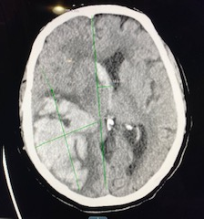
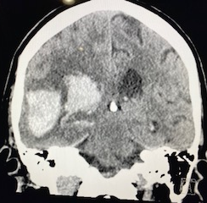
CASE #2 BROCKTON HOSPITAL

Slide 58
CASE #2 BROCKTON HOSPITAL
TREATMENT
Vitamin K
Prothrombin Complex
Labetolol for HTN
Manatol
TRANSFERRED

Slide 59
EVALUATION
CERVICAL SPINE INJURY
Older adults not part of NEXUS and other C-Spine studies
Difficult to evaluate for injury: dementia, arthritis, osteoporosis
Proportionately higher rate of cervical injuries
Minor mechanisms (fall from standing position) can result in cervical fracture.

Slide 60
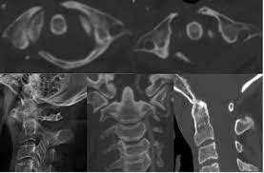
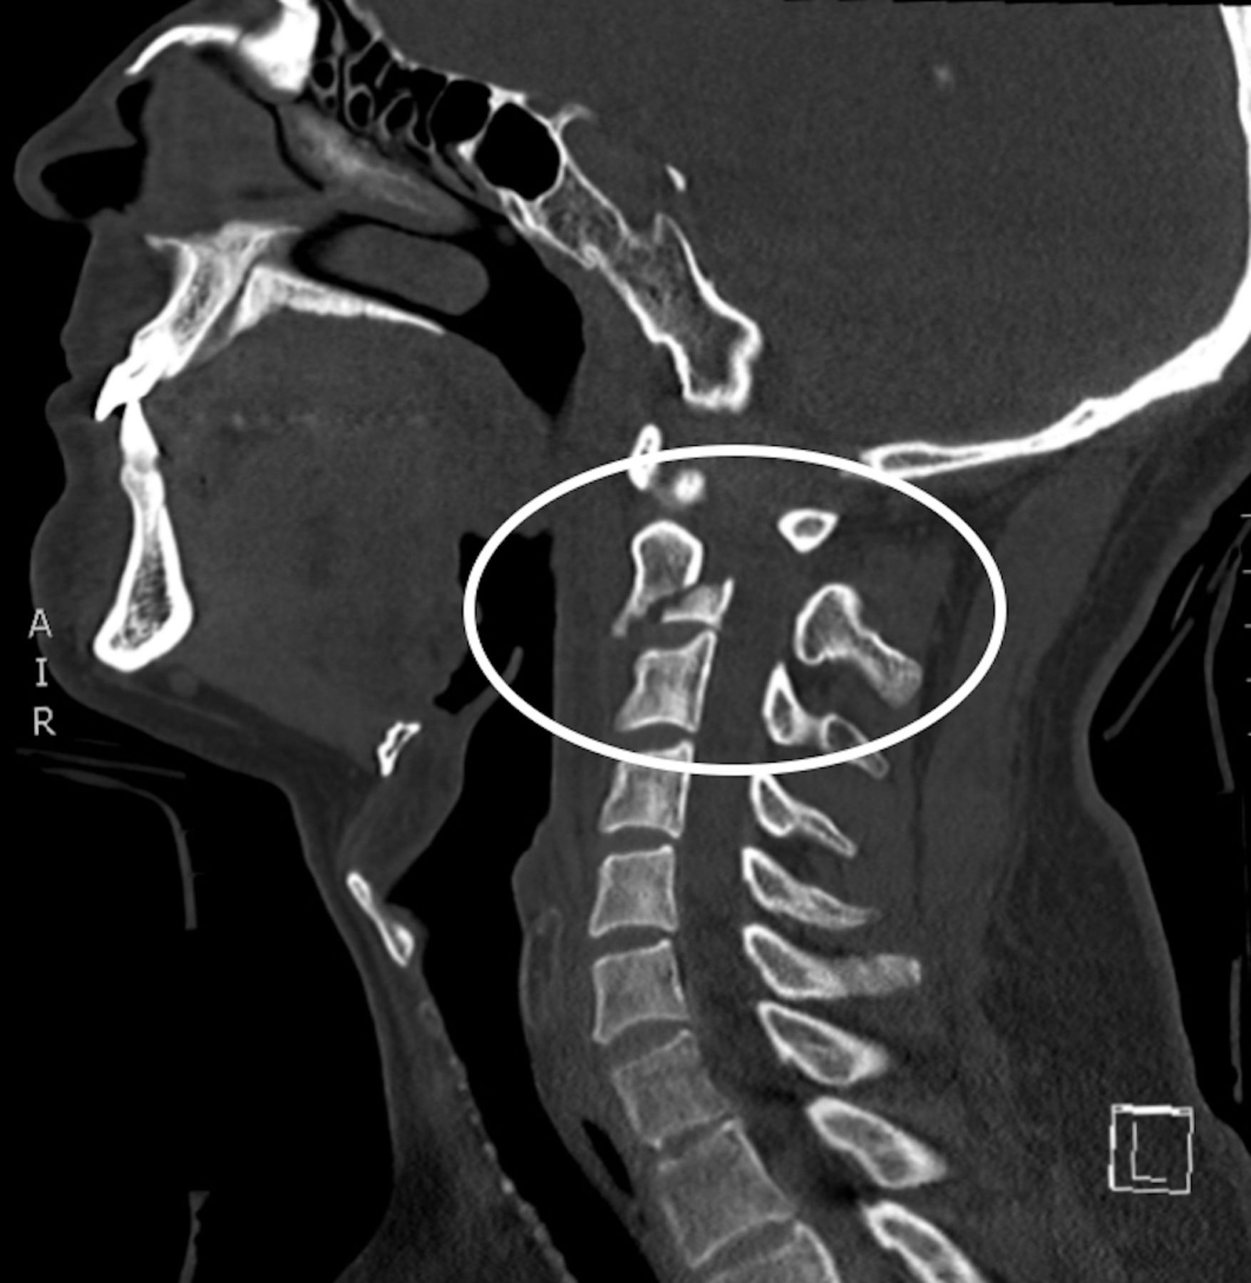
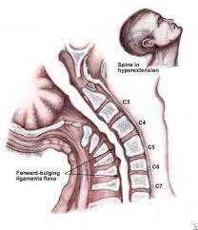
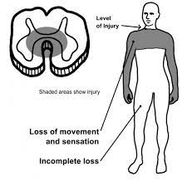
EVALUATION
CERVICAL SPINE INJURY
Susceptible to C1 and C2 fractures
CENTRAL CORD SYNDROME
Caused by hyperextension.
characterized by disproportionately greater motor impairment in upper
compared with lower extremities, bladder dysfunction, and a variable degree of
sensory loss below the level of injury

Slide 61
SELECTIVE SPINAL IMMOBILIZATION

Slide 62
SELECTIVE SPINAL IMMOBILIZATION

Slide 63
SELECTIVE SPINAL IMMOBILIZATION

Slide 64
SELECTIVE SPINAL IMMOBILIZATION
Journal of Neurotrauma VOL. 31, NO. 6 | Review normal
Prehospital Use of Cervical Collars in Trauma Patients: A Critical Review
Terje Sundstrøm, Helge Asbjørnsen, Samer Habiba, Geir Arne Sunde, and Knut Wester
Published Online: 10 Mar 2014 https://doi.org/10.1089/neu.2013.3094
Abstract
The cervical collar has been routinely used for trauma patients for more than 30 years and is a hallmark of state-of-the-art prehospital trauma care. However, the existing evidence for this practice is limited: Randomized, controlled trials are largely missing, and there are uncertain effects on mortality, neurological injury, and spinal stability. Even more concerning, there is a growing body of evidence and opinion against the use of collars. It has been argued that collars cause more harm than good, and that we should simply stop using them. In this critical review, we discuss the pros and cons of collar use in trauma patients and reflect on how we can move our clinical practice forward. Conclusively, we propose a safe, effective strategy for prehospital spinal immobilization that does not include routine use of collars.

Slide 65
EVALUATION
CHEST INJURIES
Rib fractures most common form of chest injuries in elderly
Mortality increases by about 19 percent for each rib fracture in those over 65 years of age
High risk for pulmonary infections
Worsened by comorbid pulmonary conditions like COPD

Slide 66
CASE #3
74 y/o male complained of syncope just prior to hitting a fence
01
States he became very lightheaded and not sure if he had chest pain
02
Does not recall hitting fence
03

Slide 67
CASE #3
EXAM
Normal vitals
Facial bruising
Tender chest wall with bruising
Tender abdomen

Slide 68
CASE #3

Slide 69
CASE #3
CT’s Head Neck Chest and Abdomen negative
Transferred to Boston Hospital specifically for cardiac evaluation after trauma clearance.

Slide 70
CASE #3
Seen by me again 3 days later for continued chest pain
Was admitted overnight at Boston hospital by trauma service
Never seen by cardiology
Ruled in and admitted to our hospital

Slide 71
EVALUATION
ABDOMINAL INJURIES
Injury patterns similar to younger population
Have diminished pain sensation
Harder to examine due to laxity of abdominal wall musculature

Slide 72
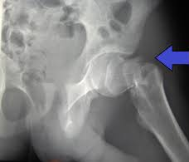
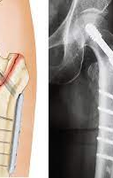
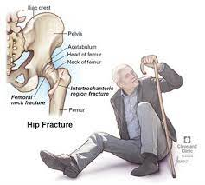
EVALUATION
MUSCULOSKELETAL INJURIES
Most common injuries
Many fractures associated with increased mortality
Hip fractures most common

Slide 73
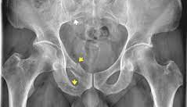
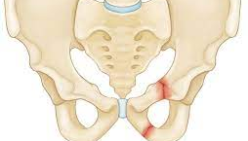
EVALUATION
MUSCULOSKELETAL INJURIES
Pelvic fractures can occur with minor trauma
Associated with greater morbidity, hemorrhaging and mortality
A retrospective study of 234 older adult patients with pelvic fractures found that patients over the age of 55 were four times more likely to die from complications of their pelvic fracture than younger patients

Slide 74
PREHOSPITAL TRIAGE

Slide 75
PREHOSPITAL TRIAGE
Prehospital care represents an essential and important part of the patient’s journey and plays a significant role in determining outcomes. One of the main principles of prehospital care is to get the right patient, to the right place, at the right time
https://www.ncbi.nlm.nih.gov/pmc/articles/PMC8009532/

Slide 76
PREHOSPITAL TRIAGE
Current triage tools predominantly assess injury severity or high-energy mechanism.
However, older people usually have injuries compounded by multimorbidity and frailty.
They also exhibit age-related anatomical and physiological changes, which could adversely affect the accuracy of the triage tool.

Slide 77
PREHOSPITAL TRIAGE BIAS
Older adults are often under triaged away from trauma centers.
Failure to recognize co-morbities
Failure to recognize serious injuries that can occur from minor mechanism
Inability (disregard?) to follow Trauma POE protocols
BIAS: The older the person is the more likely he/she will be triaged AWAY from a trauma center.
BIAS: Females more likely to be triaged AWAY from a trauma center than males

Slide 78
Geriatric Trauma Myths and Misperceptions: Part 1 & 2
https://www.acepnow.com/article/geriatric-trauma-myths-and-misperceptions-part-1/?singlepage=1&theme=print-friendly

Slide 79
GERIATRIC MYTHS
Myth 1: Transfer to a Trauma Center Is for Lifesaving Emergency Surgery Only
Patients need only be transferred to a regional trauma center if emergency surgery is likely to be required.
Older patients with nonoperative injuries benefit from specialized trauma care from coordinated multidisciplinary teams at a regional trauma center.

Slide 80
GERIATRIC MYTHS
Myth 2: Prognostication of Trauma Patients Can Be Accurately Assessed Based on Age and Comorbidities in the ED
Frailty scores have shown frailty to be more predictive of poor outcomes after trauma than age and even comorbidities.

Slide 81
GERIATRIC MYTHS
Myth 3: Volume Replacement in Trauma Patients with Hemorrhagic Shock Should Only Be Accomplished Utilizing Blood Products
Older patients are often fluid-deplete at baseline and may be taking medications such as diuretics that further deplete their volume.
In the initial resuscitation of an elderly trauma patient who may be volume-depleted at baseline, it is reasonable to give a small bolus of crystalloid (250–500 cc)

Slide 82
GERIATRIC MYTHS
Myth 4: Opioid Analgesics Should Be Withheld from Older Trauma Patients Due to Potential Adverse Effects
Undertreating and overdosing analgesics in older trauma patients are common pitfalls.
All trauma patients should have their pain treated regardless of age.
Side effects from opioids are minimized in older patients by appropriately lowering the standard adult dosages.

Slide 83
GERIATRIC MYTHS
Myth 5: Unstable C-Spine Injuries Are Unlikely After Ground-Level Fall
Older patients are more likely to sustain fractures (especially vertebral fractures) at much lower forces due to osteoporosis and reduced bone mass.
Half of cervical spine injuries in older patients are considered unstable and older patients are at higher risk for central and anterior cord syndromes.

Slide 84
BACK TO TRIAGING

Slide 85
VITALS
Consider using SBP of less than 110 for shock in the elderly
Shock Index
Respiratory Adjusted Shock Index

Slide 86
FRAILTY INDEX
GERIATRIC TRAUMA SCORE
GERIATRIC FRAILTY INDEX SCORE
Assessment scores that help to stratify risk of injury
Have not been adequately evaluated in pre-hospital setting

Slide 87
INJURY SEVERITY SCORE
Score of 15 recommends triaging to a trauma center in the elderly

Slide 88
https://www.youtube.com/watch?v=e1JLerUfkdk

Slide 89
OEMS TRAUMA POINT OF ENTRY

Slide 90
CONCLUSION
The geriatric trauma patient presents a challenge to pre-hospital EMS providers. Making triage decisions for patients with increased co-morbidities, longer medication lists and different physiological reserves is difficult compared to similar decision-making in younger trauma patients
Areas that need further study include specific aspects of trauma prevention, trauma system care, pre-hospital triage guidelines, and trauma interventions that improve both short and longterm outcomes.
https://www.ncbi.nlm.nih.gov/pmc/articles/PMC2860422/

Slide 91
AND ONE MORE THING

Slide 92
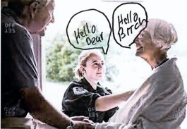
SHOW RESPECT

Slide 93
https://www.youtube.com/watch?v=eC2xpus_wJk
CURIOUS MINDS WANT TO KNOW…..WHAT REALLY GOES ON AT THE FIRE STATION??????

Slide 95
Frailty assessment has been embedded in routine care for patients requiring emergency care in the United Kingdom (UK). Applying simple frailty assessment tools using, for example, the Clinical Frailty Scale (CFS) was shown recently to independently predict 30-day mortality, inpatient delirium, and increased care level at discharge in trauma patients aged ≥65 years.²⁵ The application of the CFS in emergency care was determined to be feasible, reliable, and accurate.²⁶ However, compliance to frailty attuned scores in prehospital care may impact their effectiveness in such setting as previous evidence showed that paramedics’ compliance with trauma triage tools varied from a rate of 21% to 93%.²⁷

Slide 96
Inaba et al, (2003)⁴⁹ | ≥65 years injured patients. (ISS mean =21.4 ± 10.5) | 171 | The mean follow-up period was 2.8 years (range, 1.5–4.5 years). | From April 1, 1996, to March 31, 1999.
Findings: Following trauma, 82% of the patients in the study had physiotherapy and occupational therapy during their initial hospitalization. Eighty-one percent of these continued to had rehabilitation post discharge. Older patients aged ≥65 years had a LOS in-hospital of 22 ± 33 days compared to those aged <65 years (15 ± 20 days) (P <0.001). 14% of the patients were still having rehabilitation at long-term follow-up. 36% of the study patients were discharged home at various levels of care, 32% were discharged to a specialized rehabilitation unit, 24% were discharged to a local acute care hospital, and 9% were discharged to a chronic care institution. Prior to trauma, 125 (98%) of the study patients lived independently at home, only one patient had home care, and two patients were dependents on a spouse due to at least one of the following reasons: meal preparation, household cleaning and maintenance, personal care, and medication administration. By using these exact criteria, only 80 (63%) (P < 0.001) of the study patients at the long-term follow-up post trauma were independent at home. The remaining patients were dependents at various level, with 26 (20%) relying on home care, 5 (4%) relying on a spouse, 9 (7%) relying on a family member, and 8 (6%) relying on nursing care at an institution.

Slide 97
Benefits of MTC Access for Older Trauma Patients
Study | Population | No. of Patients | Measured Outcomes | Data Collection Period
Garwe et al, (2020)⁶⁵ | ≥55 years trauma patients with at least an ISS of 9. | 25,288 | 30-day in-hospital mortality. | Between 2005 and 2014.
Findings: Patients treated at MTCs had longer length of in-hospital stay (mean [±SD], 7.6 [7.2] vs 5.8 [5.6], P <0.0001) and higher proportion of overall unadjusted mortality compared to patients treated at non-TCs (number [%], 1118 [10.2%] vs 1081 [7.5%], P <0.0001). The majority of deaths in both groups occurred within 7 days of hospital admission (805 [72%] deaths at MTCs and 817 [75.6%] at non-TCs). The analysis of 7-day survival, after the adjustment for potential confounders, showed that the treatment of patients at MTCs was significantly associated with lower rates of death and was more significantly stronger for patients aged <65 years (HR [95% CI], 0.45 [0.36–0.56]) compared to patients aged ≥65 years (HR [95% CI], 0.65 [0.58–0.73]). Beyond 7 days, the survival benefit of the treatment at MTCs was observed (HR [95% CI], 0.68 [0.56–0.83]). The treatment at non-MTCs was associated with constantly higher 30-day cumulative risk of death. Of the study population, 18,643 were initially transported to non-MTCs. 4305 (23%) were then transferred to MTCs within 24 hours. The estimated crude mortality was significantly higher among patients who were transferred (9.2% vs 7.5%, P = 0.0005). The adjusted 30-day cumulative death risk was consistently higher in patient treated at non-MTCs compared to patients those transferred to MTCs. The restricted analysis for trauma patients with an ISS >15 marginally strengthened the protective effect of treatment at MTCs (the results were not shown). The propensity-adjusted survival analysis showed that transferring patients to MTCs was associated with significantly lower 30-day mortality for patients aged <65 years (HR [95% CI], 0.36 [0.27–0.49]) and also for patients aged ≥65 years (HR [95% CI], 0.55 [0.48–0.64]) (After the adjustment for the propensity to be transferred, ISS, presence of a serious head injury, and presence of a penetrating injury).

Slide 99
Assessment of Other Factors Not Related to Prehospital Trauma Triage Criteria
Study | Measured Factors | Findings
Garwe et al, (2017)⁷ | Distance to MTCs. | Older trauma patients were slightly injured in regions slightly away from MTCs compared to younger adults (47 vs 44 miles, P < 0.001). The study showed that even when older persons were injured in places close to MTCs, they were less likely to be transported to these centres.
Newgard et al, (2016)¹³ | Patient or Relative Choice. | >72% of hospital selections in the prehospital phase were made by patient or relative choice. The study explored the role of patient or relative choice and found inconsistent results. It was highlighted that including this factor as a measure in the triage criteria is difficult due to its subjectivity and the variations between the patients.
Chang et al, (2008)⁴ | Training, Unfamiliarity with protocols, and Possible Ageism. | Surveys of EMS personnel looking into the reasons of destination non-compliance for positively triaged older trauma patients showed that insufficient training to manage older trauma patients could be the major contributor for this issue (20%) followed by unfamiliarity with protocols (10%) ageism (such as feeling older people are not worth the extra expenditure [5%] and poor prognoses [2%]), and feeling unwelcomed when bringing patients to an MTC (2%) respectively.

Slide 100
injuries

Slide 101
tbi
https://www.youtube.com/watch?v=2z1Q7OjgFCc
https://www.youtube.com/watch?v=64fcupSbbgs

Slide 102
TRAUMA EVALUATION
Geriatric Trauma
https://www.ncbi.nlm.nih.gov/books/NBK442020/

Slide 103
ems
https://sjtrem.biomedcentral.com/articles/10.1186/s13049-021-00922-1

Slide 104
TRAUMA EVALUATION
https://www.uptodate.com/contents/geriatric-trauma-initial-evaluation-and-management

Slide 105
TRAUMA EVALUATION
https://www.east.org/education-career-development/practice-management-guidelines/archived/geriatric-trauma-evaluation-and-management-of

Slide 106
FACS TRAUMA EVAL
https://www.facs.org/-/media/files/quality-programs/trauma/tqip/geriatric_guidelines.ashx

Slide 107
TRAUMA EVAL
https://www.fairview.org/~/media/Fairview/PDFs/Trauma/FV-Trauma-Geriatric-trauma-guideline-April-2018.ashx?la=en

Slide 108
https://www.ncbi.nlm.nih.gov/pmc/articles/PMC8009532/
https://pubmed.ncbi.nlm.nih.gov/30827060/
https://pubmed.ncbi.nlm.nih.gov/24908590/
https://pubmed.ncbi.nlm.nih.gov/12970377/
https://pubmed.ncbi.nlm.nih.gov/32980868/
https://pubmed.ncbi.nlm.nih.gov/30135040/
https://www.americanjournalofsurgery.com/article/S0002-9610(21)00624-3/fulltext

