Slide 1
PEDIATRIC ADVANCE LIFE SUPPORT PART 1
DAN MUSE, MD

Slide 2
“The good news about pediatric emergencies are that there are not a lot of them…….and the bad news about pediatric emergencies are that there are not a lot of them so we always feel ill-prepared!”

Slide 3
PALS INTRODUCTION
CHAPTERS 1-3

Slide 4
PALS GOALS
TO SAVE A LIFE!
PALS provides protocols to assist you in saving an infants or child's life
PALS training improves your ability to make “rapid and accurate” assessment of an infant or child in distress, along with reassessment during management of the infant/child.

Slide 5
PALS PROTOCOLS
Protocols assume that the provider may not have all the information needed from the child or caregivers, or all the resources needed.
PALS is a set of algorithms that will assist you in achieving the best outcome.

Slide 6
RESUSCITATION TEAM

Slide 7
RESUSCITATION TEAM
Success comes with preparation:

Slide 8
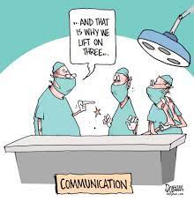
RESUSCITATION TEAM
TEAM LEADER: Need one person in charge.
Organizes the group
Monitors performance
Has the highest skill level
Directs team members
Team Members: Directed by the Team Leader
Provide care and support as directed by the Team Leader
Skilled in PALS

Slide 9
BASIC LIFE SUPPORT
CPR and AED.
Performed until higher level of care arrives.
“High-quality CPR gives the child or the infant the greatest chance of survival by providing circulation to the heart, brain, and other organs until return of spontaneous circulation (ROSC).”

Slide 10
Differences in BLS for Infants and BLS for Children
INFANTS (0 to 12 months) |  | CHILDREN ( 1 year to puberty)
According to the 2020 CPR guidelines, for all ages of children, the ratio of compressions to ventilations should be 30:2 for one provider and 15:2 for two providers.
Check for infant’s pulse using the brachial artery on the inside of the upper arm between the infant’s elbow and shoulder. | Check for child’s pulse using the carotid artery on the side of the neck or femoral pulse on the inner thigh in the crease between the leg and groin. | Check for child’s pulse using the carotid artery on the side of the neck or femoral pulse on the inner thigh in the crease between the leg and groin.
Perform compressions on the infant using two fingers (if you are by yourself) or two thumbs with hands encircling the infant’s chest (with two rescuers). | Perform compressions on a child using one or two-handed chest compressions depending on the size of the child. | Perform compressions on a child using one or two-handed chest compressions depending on the size of the child.
Compression depth should be one-third of the chest depth; for most infants, this is about 1.5 inches (4 cm). | Compression depth should be one-third of the chest depth; for most children, this is 2 inches (5 cm). | Compression depth should be one-third of the chest depth; for most children, this is 2 inches (5 cm).
If you are the only person at the scene and find an unresponsive infant or child, perform CPR for two minutes before you call EMS or go for an AED.
If you witness a cardiac arrest in an infant or child, call EMS and get an AED before starting CPR.

Slide 11
What Is Pediatric High-Quality CPR?

Slide 12
BLS INFANT CPR
0-12 MONTHS

Slide 13
BLS INFANT CPR: 0-12 MONTHS
• Check the pulse in the infant using the brachial artery on the inside of the upper arm between the infant’s elbow and shoulder.
• COMPRESSIONS:
Two fingers (with one rescuer)
Two thumb-encircling hands (if there are two rescuers and rescuer’s hands are big enough to go around the infant’s chest)
• COMPRESSION DEPTH: One-third of the chest depth; approximately 1.5 inches (4 cm).

Slide 14
BLS INFANT CPR: 0-12 MONTHS
In infants, primary cardiac events are NOT common. Usually, cardiac arrest will be preceded by respiratory problems. Survival rates improve as you intervene with respiratory problems as early as possible. Keep in mind that prevention is the first step in the Pediatric Chain of Survival.

Slide 15
BLS INFANT CPR: 0-12 MONTHS
ONE RESCUER CPR
Check to see if the infant is responsive
Breathing?
Check for a pulse: brachial or femoral and no more than 10 seconds
No pulse? Pulse less than 60? Not sure?......BEGIN CPR

Slide 16
BLS INFANT CPR: 0-12 MONTHS
ONE RESCUER CPR
Be sure the infant is face-up on a hard surface.
Using two fingers, perform compressions in the center of the infant’s chest; do not press on the end of the sternum as this can cause injury to the infant.
Compression depth should be about 1.5 inches (4 cm) and a rate of 100 to 120 per minute.

Slide 17
BLS INFANT CPR: 0-12 MONTHS
ONE RESCUER CPR
After performing CPR for about two minutes (usually about five cycles of 30 compressions and two breaths)
Get an AED if you know where one is.
Apply and follow AED prompts while continuing CPR until the infant’s condition normalizes.

Slide 18
BLS INFANT CPR: 0-12 MONTHS

Slide 19
BLS INFANT CPR: 0-12 MONTHS
TWO RESCUER CPR
EVALUATE THE INFANT AS YOU WOULD WITH SINGLE PERSON CPR
Begin CPR by performing 15 compressions by one rescuer and two breaths by the second rescuer.
Perform CPR using the two thumb-encircling hands method. Do not press on the bottom end of the sternum as this can cause injury to the infant.
Compressions should be approximately 1.5 inches (4 cm) deep and at a rate of 100 to 120 per minute.
Apply and follow AED prompts while continuing CPR until the infant’s condition normalizes.

Slide 20
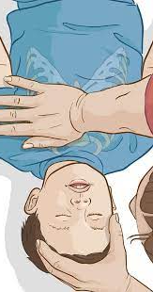
BLS CHILD CPR: 1 YEAR-PUBERTY
ONE RESCUER CPR
Check to see if the child is responsive
Breathing?
Check for a pulse: carotid or femoral and no more than 10 seconds
No pulse? Pulse less than 60? Not sure?......BEGIN CPR

Slide 21
BLS CHILD CPR: 1 YEAR-PUBERTY
ONE RESCUER CPR
Begin CPR by doing 30 compressions followed by two breaths.
Perform CPR for about two minutes (usually about five cycles of 30 compressions and two breaths)
Get or apply an AED if one is available
Follow AED prompts and continue CPR until the child’s condition normalizes.

Slide 22
BLS CHILD CPR: 1 YEAR-PUBERTY
TWO RESCUER CPR
EVALUATE THE CHILD AS YOU WOULD WITH SINGLE PERSON CPR
Begin CPR by performing 15 compressions by one rescuer and two breaths by the second rescuer.
Perform CPR with15 compressions to two breaths
Compressions should be approximately 1.5 inches (4 cm) deep and at a rate of 100 to 120 per minute.
Apply and follow AED prompts while continuing CPR until the infant’s condition normalizes.

Slide 23
BLS CHILD CPR: 1 YEAR-PUBERTY

Slide 24
BLS CHILDREN CPR: 1 YEAR TO PUBERTY

Slide 25
REVIEW QUESTIONS

Slide 26
BLS SELF-ASSESSMENT
You respond to a child or an infant that is found down. What is the next action after determining unresponsiveness?
a. Apply AED.
b. Tell a bystander to call 911.
c. Look for a parent.
d. Provide rescue breaths.
B
Early activation is key. Send any available bystanders to call 911. Many pediatric cardiac arrest situations are the result of a respiratory problem, and immediate intervention can be life-saving.

Slide 27
BLS SELF-ASSESSMENT
2. Which of the following describes the brachial pulse location?
a. Wrist - thumb side
b. Elbow - inside near forearm
c. Upper arm - inside
d. Neck - either side of the trachea
2. C
The brachial pulse is located in the upper arm.

Slide 28
BLS SELF-ASSESSMENT
3. What is the two-rescuer CPR compression to breath ratio for children and infants?
a. 30:2
b. 15:2
c. 30:5
d. 15:5
3. B
For children and infants, 15:2is the ratio for two rescuers, and 30:2 is the ratio for one rescuer.

Slide 29
BLS SELF-ASSESSMENT
4. Effective communication is key in all resuscitation attempts. Which of the following are components of effective team communication?
a. Knowledge sharing
b. Clear communication
c. Mutual respect
d. All of the above
4. D
Additional components include clear messages, knowing one’s limitations, constructive intervention, reevaluation, and summarizing.

Slide 30
TOOLS OF THE TRADE
CHAPTER 5

Slide 31
INTRAOSSEOUS ACCESS
INTRAOSSEOUS ACCESS
Useful means to administer fluids and medications in emergency situations when intravenous access cannot be performed quickly or efficiently.
ANY medication that can be given through a vein can be administered into the bone marrow without dose adjustment.
Contraindications include bone fracture, history of bony malformation, and insertion site infection.

Slide 32
INTRAOSSEOUS ACCESS
INTRAOSSEOUS ACCESS
Contraindications include bone fracture, history of bony malformation, and insertion site infection.

Slide 33
INTRAOSSEOUS ACCESS

Slide 34
https://www.youtube.com/watch?v=99DVtJSKi6k

Slide 35
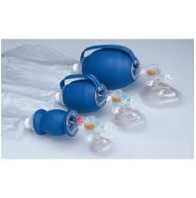
BAG-MASK VENTILATION
PROPER USE REQUIRES PROPER FIT:
Child or the infant’s mouth and nose should be covered tightly, but not the eyes.
When possible, use a clear mask
Allows visualization of the color of their lips
Can see the presence of condensation in the mask indicating exhalation.

Slide 36
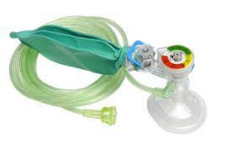
BAG-MASK VENTILATION
The two types of bag-masks: self-inflating and flow-inflating.
Self-inflating bag-mask should be the first choice in resuscitations, it should not be used in children or infants who are breathing spontaneously.
Flow-inflating bag-masks require more training and experience to operate properly
Self-Inflating Mask
Bag-Valve Masks

Slide 37
BAG-MASK VENTILATION
The minimum size bag should be 450 mL for infants and young and/or small children.
Older children may require a 1000 mL volume bag.
Proper ventilation is of utmost importance as insufficient ventilation leads to respiratory acidosis.

Slide 38
AIRWAY ADJUNCTS
Suctioning
Suctioning MOST IMPORTANT component of maintaining a patent airway in children.
Suction the airway immediately if there are copious secretions, blood, or vomit.
Attempts at suctioning should not exceed 10 seconds.
To avoid hypoxemia, follow suctioning attempts with a short period of 100% oxygen administration.

Slide 39
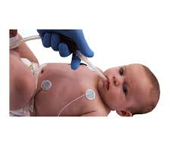
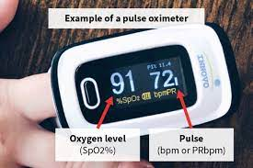
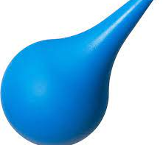
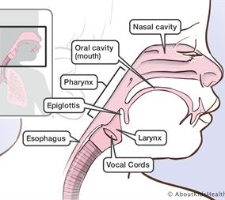
AIRWAY ADJUNCTS
Suctioning
Monitor the person’s heart rate, pulse oxygen saturation, and clinical appearance during suctioning.
If a change in monitoring parameters is seen, interrupt suctioning and administer oxygen until the heart rate returns to normal and until clinical condition improves. Assist ventilation as warranted.

Slide 40
AIRWAY ADJUNCTS
Oropharyngeal Airway
The oropharyngeal airway (OPA) keeps the soft hypopharyngeal structures and the tongue away from flopping back onto the posterior pharynx
Used on unconscious patients who don’t gag or cough when placed.

Slide 41
AIRWAY ADJUNCTS
Inserting an OPA
STEP 1: Clear the mouth of blood and secretions with suction if possible.
STEP 2: Select an airway device that is the correct size for the person.
Too large of an airway device can damage the throat.
Too small of an airway device can press the tongue into the airway.
STEP 3: Place the device at the side of the person’s face. Choose the device that extends from the corner of the mouth to the earlobe.
STEP 4: Insert the device into the mouth so the point is toward the roof of the mouth or parallel to the teeth.
Do not press the tongue back into the throat.
STEP 5: Once the device is almost fully inserted, turn it until the tongue is cupped by the interior curve of the device.

Slide 42
https://www.youtube.com/watch?v=Eue-aPxQ6us

Slide 43
AIRWAY ADJUNCTS
Nasopharyngeal Airway
The nasopharyngeal airway (NPA) is a soft rubber or plastic tube that provides a conduit for airflow between the nares and the pharynx.
It is used as an alternative to an OPA.
Unlike the oral airway, NPAs may be used in conscious or semiconscious persons (persons with intact cough and gag reflex).
Use caution or avoid placing NPAs in a person with obvious facial fractures.

Slide 44
AIRWAY ADJUNCTS
Inserting an NPA
STEP 1: Select an airway device that is the correct size for the person.
STEP 2: Place the device at the side of the person’s face. Choose the device that extends from the tip of the nose to the earlobe. Use the largest diameter device that will fit.
STEP 3: Lubricate the airway with a water-soluble lubricant or anesthetic jelly.
STEP 4: Insert the device slowly, moving straight into the face (not toward the brain).
STEP 5: It should feel snug; do not force the device into the nostril. If it feels stuck, remove it and try the other nostril.

Slide 45
https://www.youtube.com/watch?v=7L7fBx-6dFA

Slide 46
AED’S
Open
Open the pediatric AED pads
Use
If pediatric pads are not available, use adult pads.
Ensure that the pads do not touch.
Peel off backing.
Check for pacemaker or defibrillator; if present, do not apply patches over the device.

Slide 47
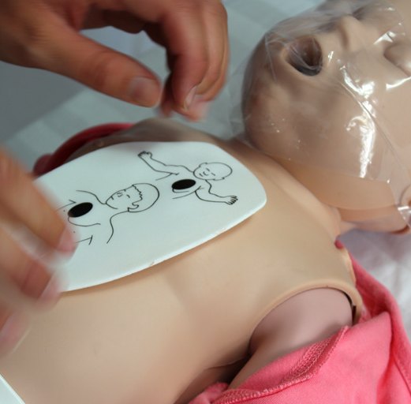
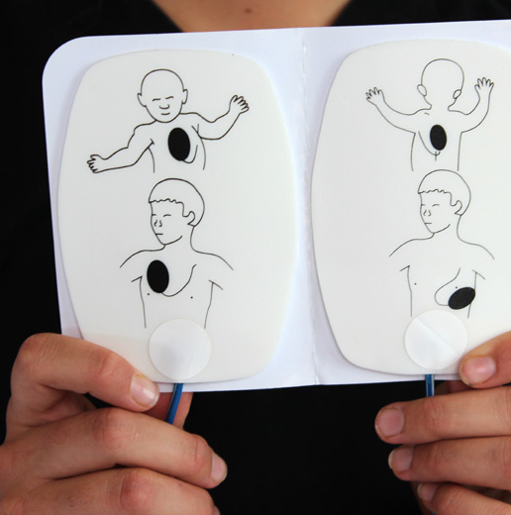
AED’S
APPLY THE PADS
a. Upper right chest above breast and under collar bone.
b. Lower left chest below armpit.
c. If pads will touch on the chest of an infant, apply one pad on the anterior chest and another pad on the posterior of the infant instead.
If the AED is not working properly, continue giving CPR.
Do not waste excessive time troubleshooting the AED.
CPR always comes first; AEDs are supplemental.
Do not use AED in water.

Slide 48
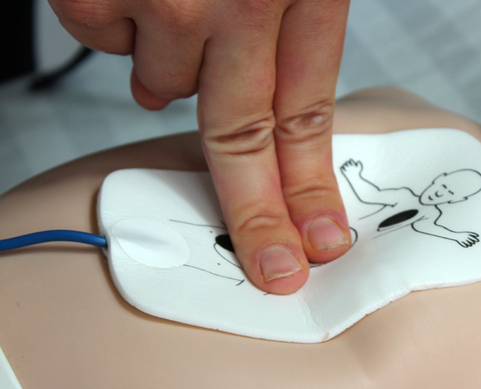
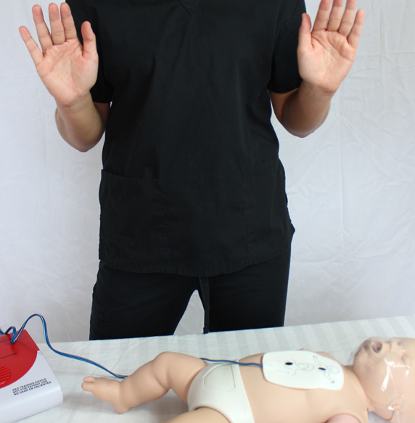
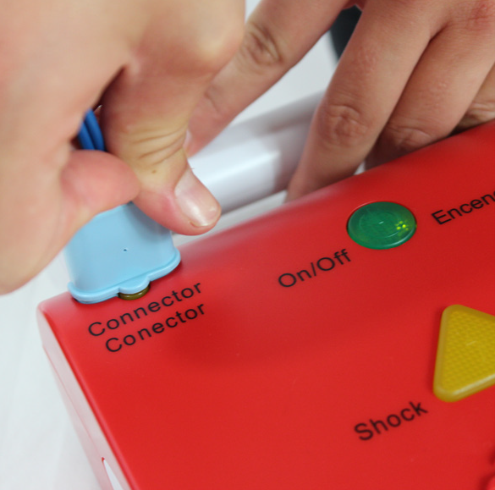
AED’S
AED Steps for Children and Infants Continued
Ensure wires are attached to AED box
Move away from the person.
a. Stop CPR.
b. Instruct others not to touch the person.
AED analyzes the rhythm.
If message reads “Check Electrodes,” then:
a. Ensure electrodes make good contact.
b. If message reads “Shock,” then shock.
Resume CPR for two minutes.
Repeat cycle.

Slide 49
https://www.youtube.com/watch?v=wE3QN1IMFfg

Slide 50
ASSESSMENT
CHAPTER 4

Slide 51
PEDIATRIC ASSESSMENT
Kids compensate…..Then fall over the edge!
Act quickly and be decisive.
AND THINK RESPIRATORY

Slide 52
PEDIATRIC ASSESSMENT

Slide 53
PEDIATRIC ASSESSMENT
GOAL: Keep OXYGENATED blood flowing to the brain.
AIRWAY
BBREATHING
CIRCULATION
DISABILITY
EXPOSURE

Slide 54
PEDIATRIC ASSESSMENT
INITIATE RESCUE BREATHING if the problem is respiratory
BEGIN HIGH-QUALITY CPR if breathing is ineffective and pulses are inadequate.
60 beats per minute is required to maintain adequate perfusion in a child or an infant..any less, begin CPR
YES
IS THE CHILD/INFANT RESPONSIVE?
NO
YES
IS THE CHILD/INFANT BREATHING EFFECTIVELY?
NO
DIAGNOSE AND TREAT
RESCUE BREATHING
YES
IS THERE AN ADEQUATE PULSE?
NO
START CPR
Figure 6

Slide 55
PEDIATRIC ASSESSMENT: AIRWAY
Is the airway open? | • This means open and unobstructed • If yes, proceed to Breathing
Can the airway be kept open manually? | • Jaw-Lift/Chin-Thrust • Nasopharyngeal or oropharyngeal airway
Is an advanced airway required? | • Endotracheal intubation • Cricothyrotomy, if necessary

Slide 56
PEDIATRIC ASSESSMENT: BREATHING
Is breathing too fast or too slow? | • Tachypnea has an extensive differential diagnosis • Bradypnea can be a sign of impending respiratory arrest
Is there increased respiratory effort? | • Signs of increased respiratory effort include nasal flaring, rapid breathing, chest retractions, abdominal breathing, stridor, grunting, wheezing, and crackles
Is an advanced airway required? | • Endotracheal intubation • Cricothyrotomy, if necessary

Slide 57
PEDIATRIC ASSESSMENT: CIRCULATION
AGE | NORMAL HEART RATE (AWAKE) | NORMAL HEART RATE (ASLEEP) | NORMAL BLOOD PRESSURE (SYSTOLIC) | NORMAL BLOOD PRESSURE (DIASTOLIC) | HYPOTENSION BLOOD PRESSURE (SYSTOLIC)
Neonate | 85-190 | 80-160 | 60-75 | 30-45 | <60
One Month | 85-190 | 80-160 | 70-95 | 35-55 | <70
Two Months | 85-190 | 80-160 | 70-95 | 40-60 | <70
Three Months | 100-190 | 75-160 | 80-100 | 45-65 | <70
Six Months | 100-190 | 75-160 | 85-105 | 45-70 | <70
One Year | 100-190 | 75-160 | 85-105 | 40-60 | <72
Two Years | 100-140 | 60-90 | 85-105 | 40-65 | <74
Child (2 to 10 years) | 60-140 | 60-90 | 95-115 | 55-75 | <70 + (age x 2)
Adolescent (over 10 years) | 60-100 | 50-90 | 110-130 | 65-85 | <90

Slide 58
PEDIATRIC ASSESSMENT
GREATER THAN ONE: 70 + (2 X AGE)

Slide 59
PEDIATRIC ASSESSMENT: DEFICIT
AWAKE | May be sleepy, but still interactive
RESPONDS TO VOICE | Can only be aroused by talking or yelling
RESPONDS TO PAIN | Can only be aroused by inducing pain
UNRESPONSIVE | Cannot get the patient to respond

Slide 60
PEDIATRIC ASSESSMENT: DEFICIT
AREA ASSESSED | INFANTS | CHILDREN | SCORE
Eye-opening | Open spontaneously | Open spontaneously | 4
 | Open in response to verbal stimuli | Open in response to verbal stimuli | 3
 | Open in response to pain only | Open in response to pain only | 2
 | No response | No response | 1
Verbal response | Coos and babbles | Oriented, appropriate | 5
 | Irritable cries | Confused | 4
 | Cries in response to pain | Inappropriate words | 3
 | Moans in response to pain | Incomprehensible words or nonspecific sounds | 2
 | No response | No response | 1
Motor response | Moves spontaneously and purposefully | Obeys commands | 6
 | Withdraws to touch | Localizes painful stimulus | 5
 | Withdraws in response to pain | Withdraws in response to pain | 4
 | Responds to pain with decorticate posturing (abnormal flexion) | Responds to pain with flexion | 3
 | Responds to pain with decerebrate posturing (abnormal extension) | Responds to pain with extension | 2
 | No response | No response | 1

Slide 61
PEDIATRIC ASSESSMENT: EXPOSURE
EXPOSURE
Trauma…..burns, fractures, and any other obvious sign that might provide a clue as to the cause of the current problem.
Skin temperature…fever, hypothermia
Skin color… cardiovascular system, tissue perfusion: mottling, cyanosis
Skin changes…..petechiae or bruising.
Exposure to the elements….Keep warm

Slide 62
PEDIATRIC ASSESSMENT: SECONDARY ASSESSMENT
S: SIGNS & SYMPTOMS
• Evaluate recent events related to current problem -Preceding illness, dangerous activity
• Examine patient from head to toe for the following: - Consciousness, delerium - Agitation, anxiety, depression - Fever - Breathing - Appetite - Nausea/vomiting - Diarrhea (bloody)
P: PAST MEDICAL HISTORY
• Complicated birth history
• Hospitalizations
• Surgeries
A: ALLERGIES
• Any drug or environmental allergies
• Any exposure to allergens or toxins
M: MEDICATIONS
• What medications is the child taking (prescribed and OTC)?
• Could child have taken any

Slide 63
RSV

Slide 64
EMS
Dispatched for baby with shortness of breath. Upon arrival police on scene.
Police on scene x2 providing CPR.
Patient presents as eyes open and rolling around, taking irregular almost agonal breaths.
Lung sounds clear on the left but diminished on right. Also odd heart sounds on right side.
Parents report patient has history of heart murmurs.

Slide 65
EMS
Picked up and carry to ambulance.
Put patient into the stretcher via carry and secured to stretcher.
Put patient on blow-by O2 via nonrebreather.
Put patient on a monitor.
Initial O2 sat 42%. Patient presenting as though he had an obstruction.

Slide 66
EMS
Seems to be working to get air in every 3 to 4 breaths resulting in huge seemingly agonal breaths.
Began bagging patient and put patient on end-tidal CO2.
Initial end-tidal CO2 number is 82.
Improving throughout transport.

Slide 67
EMS
BP | PULSE | RESPIRATORY | SPO2 | ETCO2
 | 165 | 35 labored irregular | 42%
 | 162 | 33 labored irregular | 55%
 | 148 | 35 labeled irregular | 98% | 82
127/94 | 150 | 33 labored irregular | 88% | 75

Slide 68
CASE #1: BH ER
Temp | Pulse | Resp | BP | Pulse Ox
07/02/22 10:28 | 101.0 F H | 156 H | 36 H | 127/94 H | 100
INTUBATED #5 TUBE

Slide 69
CASE #1: BH ER
HPI Narrative: 2-year-old male presents today with chief complaint of altered mental status respiratory distress. At approximately 945-10 AM he was found lethargic, and in respiratory distress by parents, 911 called, police department arrived first, found him lethargic, started CPR, EMS arrived, found with a pulse ox in the 40s, but did have a pulse, they placed him on supplemental oxygen, pulse ox came up to 70s. On arrival to the emergency department he remained altered, lethargic, and in respiratory distress. Limited outside history is initially available, patient apparently has a prior history of pulmonic stenosis, ASD, obstructive sleep apnea, tonsillar hypertrophy

Slide 70
CASE #1: BH ER
General: Obtunded, obvious respiratory distress. Cardiac: Regular tachycardia in the 150s, unable to auscultate heart tones distinctly due to respiratory distress and increased work of breathing.
Pulmonary: Marked tachypnea with bag ventilation from EMS, seems somewhat diminished on right side at time of initial contact.
Abdominal: Soft, non TTP in all areas, no masses palpated, no overlying skin changes Neuro: Grossly no focal neurologic deficits, patient does move his bilateral upper and lower extremities in response to noxious stimuli.

Slide 71
CASE #1: BH HOSPITALIST
History of present illness: Pt is a 2yr boy c/hx of Congenital heart disease (pulmonic stenosis, ASD, VSD) now c/unresponiveness. Pt was a FT infant dx c/congenital hrt disease by prenatal U/S. Followed at BCH by cardiology and not on any medications. Corrective surgery not decided on yet. Pt has hx of bradycardia in past but no tachyarrhymias. Pt had a hx of a febrile sz in past as well. Awoke this am and was well. Had a bottle and then 1hr later father said he lay down for a nap. Father went to check on him and noted he had some grunting respirations then stopped breathing. Called 911 and when EMS arrived pt's O2 sats in the 40's. Bagged up to 80's but pt remained unresponsive to voice/touch. Brought to ED and intubated. Noted to be febrile to 101. No hx of cold symptoms nor fever at home. No sick contacts. In daycare. NL PO intake and activity previous to today.

Slide 72
CASE #1: BH HOSPITALIST
Assessment and Recommendations Assessment and Recommendations: Pt is a 2yr boy c/hx of congenital hrt disease now with an episode of unresponsiveness. Pt was febrile when arrived at ED and had a previous episode of febrile sz, but uncertain if this is what is going on since unwitnessed. Father found pt grunting and then apneic - doubtful this is primary respiratory event. CXR looks clear, so no pneumonia and no look of aspiration. Possible cardiac of origin, but unlikey. Pt should be transferred to BCH where his cardiologist is and can be fully evaluated for etiology of event. Should be given a dose of Ceftriaxone. Had BCX and UCX (though a bag specimen) sent first.

Slide 73
CASE #2

Slide 74
CASE #2: EMS
Discharge for child not waking up. Upon arrival 3-year-old boy being carried out by mother to the ambulance. Pulseless and apneic and blue at the lips. CPR started by fire department. Pads placed front and back. Per mother child has asthma and autism. Born with methadone addiction.

Slide 75
CASE #2: EMS
Child has trismus but able to suction saliva in place OPA with bag-valve-mask assisted ventilations by BLS. After about 2 minutes of CPR, ROSC obtained with respiratory distress and belly breathing. Lung sounds wheezes. End-tidal CO2 70 mmHg. IO placed left tibia. Child remained unconscious for duration of transportation. BP 140/60. Pulse 120. Regular.

Slide 76
CASE #2: EMS
TIME | BP | PULSE | RESPIRATORY | SAO2 | ETCO2
0230 | 140/60 | 120 | 30 LABORED |  | 70
0237 | 140/60 | 120 | 30 LABORED |  | 70

Slide 77
BH-ER
Initial Comments: 3-year-old male brought in by EMS for evaluation of respiratory distress. Mom states over the past several nights the child has had nasal congestion at bedtime. She has been using nasal saline spray. Tonight she attempted to do this and noticed that he did not stir with administration. She turn the light on to find him cyanotic with belly breathing. She called EMS who instructed her to perform CPR. On EMS arrival the child had a pulse with weak respiratory effort. An IO was placed and he was ventilated with bag valve mask and transported here. In route he was hypoxic in the high 70s to low 80s.

Slide 78
BH-ER
General: Limitations: altered mental status General appearance: other (Unresponsive, pallor) Chest Present symmetric chest wall rise Respiratory respiratory distress, accessory muscle use and Rales rhonchi bilaterally
Cardiovascular Cardiovascular exam: Present tachycardia Extremities Exam Extremities exam: Present normal capillary refill (Sluggish initially) Neurological Exam Neurological exam: Unresponsive

Slide 79
BH-ER
Intubated: #5 ETT. #2 Macintosh blade
CXR Negative

Slide 80
CASE #3

Slide 81
CASE #3:EMS
14 y/0 for asthma attack. CPR in progress
“Supine, unconscious, unresponsive, no pulse, not breathing, extremely cyanotic” Police performing CPR
Mother states patient was eating hot dogs when he suddenly became SOB. Did not appear to be choking.
Unknown PMX by mother. Received 2 rounds with EpiPen

Slide 82
CASE #3:EMS
Carried out by police and secured to stretcher
CPR with lucas
Ventilated with BVM and OPA
PEA; 20 ga IV; EPI every 3-5 minutes
Began vomiting
ETT #6: ”ETCO2 in 30’s with good wave form”
Continued to vomit into the tube and was suctioned
Color improved with ventilation. Hives noted on both arms

Slide 83
CASE #3:EMS

Slide 84
CASE #3: HOSPITAL
HPI
Per aunt pt was eating hot dog. No aspiration per aunt
Became sob and given EpiPen
Within minutes stopped breathing
EMS and police on scene within 2 minutes. Blue from neck up
No pulse, CPR with/without lucas started
Arrived in PEA

Slide 85
CASE #3: HOSPITAL
PE: Pulseless.
HEENT: no trauma. Eczematous rash to the face
Respiratory: BS very tight with poor air movement on arrival. BS equal bilaterally.
EXT: mottled
Neurologic: GCS 3, blown pupils

Slide 86
CASE #3: HOSPITAL
Reintubated with 7.5 for bronchoscopy: neg for foreign body
MEDS:
Solumedrol
Duonebs
Ketamine for broncho-dilitation
2 gm magnesium
Rocuronium for paralysis to help bagging
Epinephrine
Saline

Slide 87
CASE #3: HOSPITAL
Following pronouncement stepfather states patient had stated that he got hit in the head with piece of metal the day before
No signs of head trauma

Slide 88
RESPIRATORY
PALS 2
JANUARY 25, 2023
www.brocktonems.com

Slide 89
https://youtu.be/ljAmkMZno6w

Slide 90
RESPIRATORY DISTRESS
RESPIRATORY COMPLICATIONS TYPICALLY IMPACT INFANTS AND CHILDREN
Oxygenation: The ability to provide oxygen to red cells.
Ventilation: The ability to exchange oxygen for carbon dioxide.
Respiratory Distress: When the person cannot ventilate.
“In its simplest form, respiratory distress is a condition in which pulmonary activity is insufficient to bring oxygen to and to remove carbon dioxide from the blood.”

Slide 91
RESPIRATORY DISTRESS
OXYGENATION
Is oxygen available? | Is lung blood flow adequate? | Can gases cross the pulmonary vasculature?
Ex. High altitudes have low O₂ | Ex. Vascular shunts may not send blood to lungs | Ex. Pulmonary edema or pneumonia
VENTILATION
Is the airway clear? | Are the muscles of the chest functioning? | Is the rate of breathing sufficient?
Ex. An obstructed airway prevents gas flow | Ex. Chest muscle fatigue can occur | Ex. CNS depression can slow/stop breathing

Slide 92
RESPIRATORY DISTRESS
Abnormal breath sounds
STRIDOR | Upper airway obstruction (foreign body)
GRUNTING | Upper airway obstruction (swollen airway) Pneumonia (grunting to recruit alveoli)
WHEEZING | Lower airway obstruction (asthma)
CRACKLES | Fluid in lungs (wet) Atelectasis (dry)
ABSENT/DECREASED BREATH SOUNDS | Collapsed lung (air, blood) Lung tissue disease (pneumonia)

Slide 93
CAUSES OF RESPIRATORY DISTRESS
UPPER AIRWAY |  | LOWER AIRWAY |  | LUNG TISSUE DISEASE |  | CNS ISSUES
Cause | Treatment | Cause | Treatment | Cause | Treatment | Cause | Treatment
CROUP | Dexamethasone Oxygen (Heliox) Nebulizer (epinephrine) Intubate Tracheostomy | BRONCHIOLITIS | Suctioning Nebulizers | PNEUMONIA | Dexamethasone Oxygen (Heliox) Nebulizer (epinephrine) Intubate Tracheostomy | OVERDOSE | Naloxone (opioid reversal) Antidotes Support breathing
FOREIGN BODY | Dexamethasone Oxygen (Heliox) Nebulizer (epinephrine) Intubate Tracheostomy | ASTHMA | Oxygen (Heliox) Nebulizers (albuterol and ipratropium bromide) Corticosteroids Magnesium sulfate Epinephrine SQ Support breathing | PNEUMONITIS | Antibiotics (bacterial) Nebulizers Support breathing | TRAUMA | Neurosurgery Reduce intracranial pressure Support breathing
ANAPHYLAXIS | Epinephrine IM Nebulizer Diphenhydramine |  |  | PULMONARY EDEMA | Diuretics Inotrope Support breathing

Slide 94
CAUSES OF RESPIRATORY DISTRESS
CAUSES OF RESPIRATORY DISTRESS/FAILURE
Respiratory distress or failure generally falls into one of four broad categories.
UPPER AIRWAY: Croup, Foreign Body, Abscess, Anaphylaxis
LOWER AIRWAY: Bronchiolitis, Asthma
LUNG TISSUE DISEASE: Pneumonia, Pneumonitis, Pulmonary Edema
CENTRAL NERVOUS SYSTEM (CNS) ISSUES. Overdose, Head Trauma

Slide 95
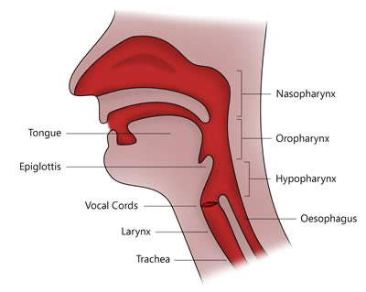
CAUSES OF UPPER AIRWAY OBSTRUCTION

Slide 96
CAUSES OF UPPER AIRWAY OBSTRUCTION
Infection: epiglottitis, croup, bacterial tracheitis, retropharyngeal abscess, mononucleosis
Foreign body
Trauma
Burns
Angioedema/anaphylaxis

Slide 97
INVASIVE GROUP A STREP
Invasive disease means that germs invade parts of the body that are normally free from germs. When this happens, disease is usually very severe, requiring care in a hospital and even causing death in some cases. Necrotizing fasciitis and streptococcal toxic shock syndrome are examples of iGAS infections.
https://www.ncbi.nlm.nih.gov/pmc/articles/PMC7100837/

Slide 98
INVASIVE GROUP A STREP
The group A streptococcus (GAS) causes a wide diversity of clinical disease in humans
pharyngitis and impetigo,
post-streptococcal sequelae, such as acute rheumatic fever and acute glomerulonephritis, to invasive infections.
The definition of an invasive infection is one in which GAS infects a normally sterile site.
Invasive infections have a fatality rate, especially when associated with streptococcal toxic shock syndrome (STSS).
NEED TO BE PICKED UP EARLY!
https://www.ncbi.nlm.nih.gov/pmc/articles/PMC7100837/

Slide 99
INVASIVE GROUP A STREP
Case definition for streptococcal toxic shock syndrome
Isolation of group A streptococcus (Streptococcus pyogenes) from a normally sterile site (eg, blood, cerebrospinal fluid, pleural fluid)*
and
Hypotension (fifth percentile of systolic blood pressure for children or less than 90 mmHg for adolescents)
and two or more of:
Renal impairment (creatinine greater than two times the upper limit for age) Coagulopathy (platelets less than 100,000 ×10⁶ U/L or evidence of disseminated intravascular coagulopathy) Liver involvement (alanine aminotransferase, aspartate amino-transferase or bilirubin greater than two times upper limit of normal) Adult respiratory distress syndrome (pulmonary infiltrates and hypoxemia without heart failure or generalized edema) Generalized erythematous rash that may desquamate Soft tissue necrosis in the form of necrotizing fasciitis, myositis or gangrene
https://www.ncbi.nlm.nih.gov/pmc/articles/PMC2828231/

Slide 100
INVASIVE GROUP A STREP
Clinical
Influenza-like symptoms such as fever, aches, pains and chills
Severe pain
Rapid breathing, signs of pleural effusion
Secondary fever following varicella infection suggests invasive group A streptococcus disease
https://www.ncbi.nlm.nih.gov/pmc/articles/PMC2828231/

Slide 101
EPIGLOTTITIS
Swelling to the epiglottis causing obstruction above the vocal cords.
Typically has a very rapid onset
Has had a major decline since the advent of the Haemophilus Influenza Type B Vaccine

Slide 102
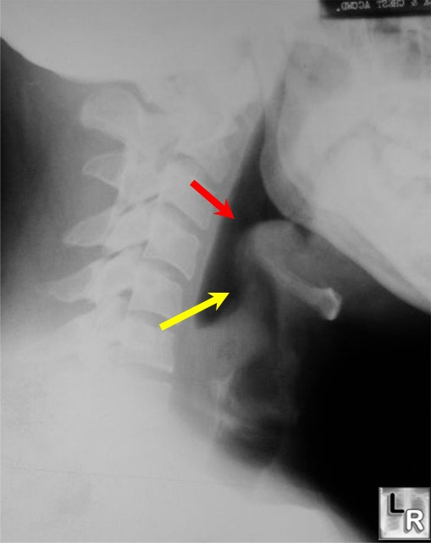
EPIGLOTTITIS
Lateral radiograph of the neck demonstrates and enlarged epiglottis (red arrow) and thickening of the aryepiglottic folds (yellow arrow).

Slide 103
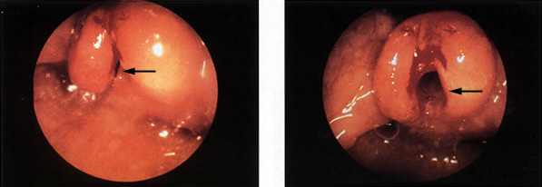
EPIGLOTTITIS
On the left, an endoscopic view of the throat shows almost complete blockage of the airway (arrow). This finding is typical of epiglottitis. On the right, the airway has been opened (arrow) after insertion and removal of an endotracheal tube, although some redness and blood remain.

Slide 104
CROUP
AKA: Laryngotracheobronchitis.
Causes swelling below the vocal cords
Has a characteristic barking cough
Viral
Can be mild to life threatening.
Most common between 6 and 36 months.

Slide 105
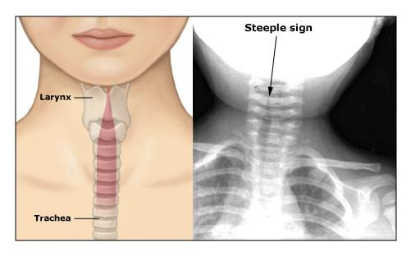
CROUP

Slide 106
EPIGLOTTITIS VS CROUP
EPIGLOTTITIS
CROUP
Most commonly H. Flu type- b
Peak incidence now closer to 6-7 years
Obstruction above “epi” the glottis
Most commonly viral
Peak incidence is from 6 months to 2 years but can be seen up to 5-6 years of age.
Obstruction below the glottis

Slide 107
BACTERIAL TRACHEITIS
Bacterial infection of the trachea
Generally associated with severe difficulty breathing and high fevers
Typically occurs in children older than the “croupers”

Slide 108
RETROPHARYNGEAL ABSCESS
The mass of the abscess can compress the airway
Associated with a complaint of sore throat, neck pain and fever.
Not an acute airway obstruction but builds up as the swelling increases.

Slide 109
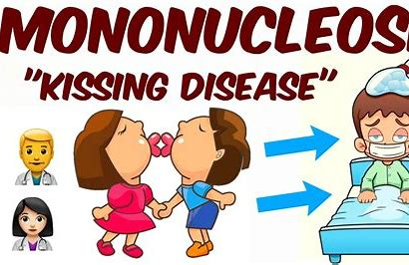
MONONUCLEOSIS
Rare but potential cause of obstruction due to tonsillar enlargement and mucosal edema.

Slide 110
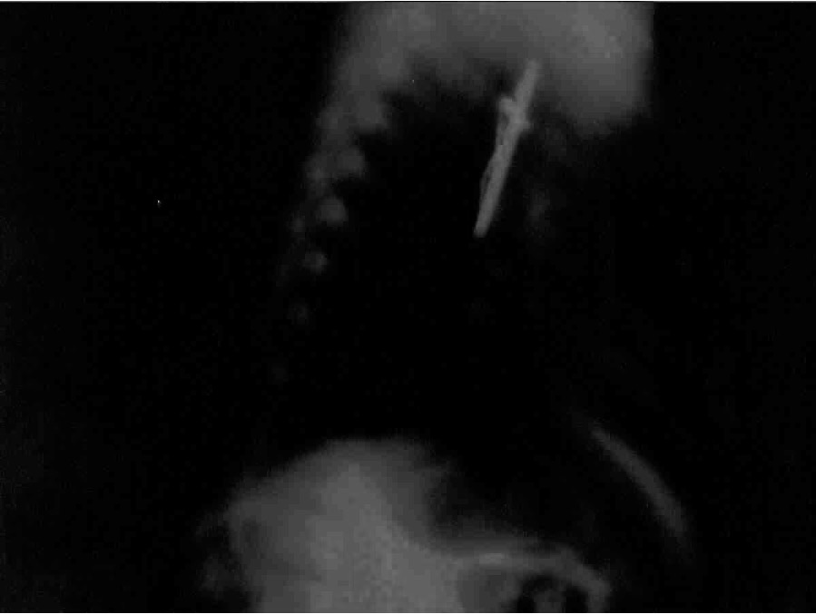
Mother’s response when seeing the x-ray….. ”I’ve been looking for that cross”

Slide 111
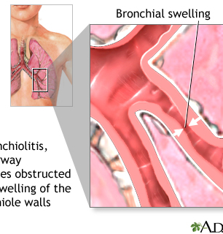
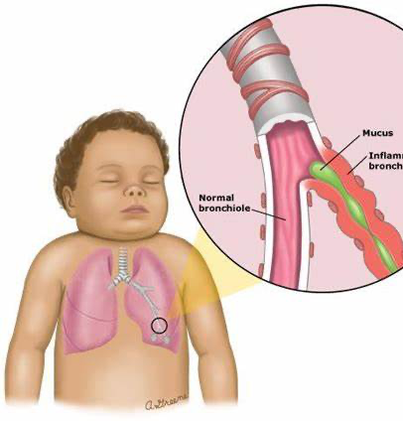
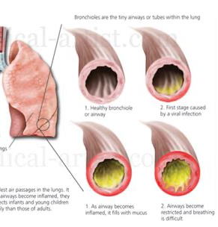
CAUSES OF LOWER AIRWAY DISTRESS

Slide 112
https://www.youtube.com/watch?v=9EZuhlSNUv0

Slide 113
BRONCHOLITIS
Common in young kids
Most common under the age of 2
Caused by viruses
RSV (most common 30%)
Human Metapneumovirus
Coronavirus
Parainfluenza Virus
Human Rhinovirus

Slide 114
BRONCHOLITIS
Upper (nose & throat) and Lower airway (bronchioles) get plugged up
Large amount of mucous production clog the air passages
Air gets trapped
Diminished air exchange (ventilation)
Patches of the lungs collapse and don’t function (atelectasis)
Can be mild to severe

Slide 115
BRONCHOLITIS
TREATMENT: SYMPTOMATIC CARE
SUCTION, SUCTION, SUCTION………….
Humidified Oxygen
Hydration
These children need aggressive hydration. The use of beta-adrenergic agonists like epinephrine or albuterol, or even steroids, has not been shown to be effective in children with bronchiolitis.
https://www.ncbi.nlm.nih.gov/books/NBK441959/

Slide 116
ASTHMA
Most common chronic illness in children (> 6 million in US)
> 700,000 ED visits each year
2%-5% of all pediatric hospitalization

Slide 117
ASTHMA: HISTORY
HISTORY is vital to determine if the child has asthma.
Not all wheezing is asthma.
Not all coughing is a cold. (Cough Variant Asthma)

Slide 118
ASTHMA: EXAM
WHEEZING most common finding
Wheezing typically more prominent on expiratory phase
Lack of wheezing in asthmatic attack can be a harbinger of respiratory failure

Slide 119
ASTHMA: EXAM
Focus on mental status and respiratory
Fussy & crying…reassuring. Quiet, listless…..get ready for the worst!
Respiratory: grunting…nasal flaring..head bobbing….retractions….signs of work of breathing

Slide 120
OEMS PROTOCOL 2.6P
EMT
MILD DISTRESS: The following may be considered if the patient has not taken the prescribed maximum dose of their own inhaler prior to the arrival of EMS and the inhaler is present:
Encourage and/or assist patient to self-administer their own prescribed inhaler medication if indicated or if not already done.
If patient is unable to self-administer their prescribed inhaler, administer patient’s prescribed inhaler.
Reassess vital signs.
SEVERE DISTRESS:
If properly trained and authorized, use 6.1 BLS Bronchodilators Adult and Pediatric
If patient is over 6 months age and under 25kg, administer epinephrine 0.15mg via auto-injector or IM. If body weight is over 25 kg, administer epinephrine 0.3mg via auto-injector or IM. When administering IM, EMTs may do so in accordance with Protocol 6.6 Check and Inject Epinephrine by EMT-Basics.

Slide 121
OEMS PROTOCOL 2.6P
EMT
MEDICAL CONTROL MAY ORDER:
Additional doses of above medications if prescribed to patient or authorized and if maximum dose has not been administered.
Criteria for Epinephrine administration:
age greater than or equal to 6 months
known history of asthma or reactive airway disease or bronchospasm or bronchodilators prescribed AND
patient in respiratory arrest or approaching respiratory arrest (requiring BVM)-include diminished or absent breath sounds AND oxygen saturation less than 91% despite supplemental oxygen or unmeasurable.
TAKE AWAY: UTILIZE MEDICAL CONTROL!

Slide 122
OEMS PROTOCOL 2.6P
ADVANCED EMT STANDING ORDERS
If the condition is not improving with administration of supplemental oxygen, consider the following:
Albuterol sulfate 1.25 mg with ipratropium bromide, 250 mcg via nebulizer if less than 2 years of age.
Albuterol sulfate 2.5-3 mg with ipratropium bromide, 500 mcg via nebulizer if age 2 years or greater.
A second dose of albuterol, with or without ipratropium bromide, may be administered as necessary.
Note: a multi-dose inhaler may be used to give albuterol or ipratropium (instead of nebulizer) if infection control is an issue (e.g., influenza-like-illness).
SEVERE DISTRESS:
If patient is over 6 months age and under 25kg, administer epinephrine 0.15mg via auto-injector or IM. If body weight is over 25 kg, administer epinephrine 0.3mg via auto-injector or IM.
Contact Medical Control if second dose is required after 5 minutes.

Slide 123
OEMS PROTOCOL 2.6P
PARAMEDIC STANDING ORDERS
For a child age 2 years old or more who has a known diagnosis of asthma, consider: hydrocortisone 2 mg/kg to max. 100 mg IV/IO/IM; or methylprednisolone 2 mg/kg to max. 125 mg IV/IO/IM.
Consider magnesium sulfate 25 mg/kg IV/IO over 10 min. (maximum dose 2 grams).
MEDICAL CONTROL MAY ORDER
Additional doses of above medications.

Slide 124
OEMS PROTOCOL 2.6P
RED FLAG: CAUTION: Epinephrine for anaphylaxis must be administered by Auto-Injector or IM if trained and authorized to do so in accordance with Medical Director Option Protocol 6.5 Check and Inject Epinephrine by EMT-Basics.
Red Flag: For patients under 12 years old, the airway is in most cases best managed with a BVM or SGA. In some cases, intubation may be preferred. This is at the discretion of the treating paramedic.
Mild distress in children is evidenced by minor wheezing and good air entry.
Severe distress in children is evidenced by poor air entry, extreme use of accessory muscles, nasal flaring, grunting, cyanosis and/or altered mental status (weak cry, somnolence, poor responsiveness). REMEMBER: Severe bronchospasm may present without wheezes, if there is minimal air movement.
Respiratory Distress is defined as inadequate breathing in terms of rate, rhythm, quality and/or depth of breathing. Children who are breathing too fast or slow, or in an abnormal pattern or manner, may not be receiving enough oxygen to support bodily functions and may allow an increase in carbon dioxide to dangerous levels. Cyanosis is usually a late sign and requires immediate treatment.

Slide 125
DOES IPRATROPIUM BROMIDE HELP IN ASTHMA
Results: Among 175 patients included in the analysis, 102 patients were treated with IB (IB group) and 73 patients were treated without IB (Non-IB group). A propensity score matching analysis extracted 63 patients from each group. There was no statistical difference between the two groups in terms of admission rate (IB group 12.7% vs Non-IB group 9.5%; p=0.78). One patient (1.0%) treated with IB experienced dryness of the mouth, which resolved spontaneously.
[IPRATROPIUM BROMIDE FOR ACUTE ASTHMA IN CHILDREN: A RETROSPECTIVE TRIAL]
Osamu Nomura ¹, Yoshihiko Morikawa ², Yusuke Hagiwara ¹, Takateru Ihara ¹, Nobuaki Inoue ¹, Hiroshi Sakakibara ³, Akira Akasawa ⁴
Arerugi. 2017;66(7):945-952.doi: 10.15036/arerugi.66.945.
PMID: 28824036
DOI: 10.15036/arerugi.66.945

Slide 126
DOES IPRATROPIUM BROMIDE HELP IN ASTHMA
randomized controlled studies of pediatric asthma exacerbation and a meta-analysis of pediatric asthma patients suggest that ipratropium added to beta2-agonists improves lung function and also decreases hospitalization rates, especially among children with severe exacerbations of asthma.
The use of ipratropium bromide for the management of acute asthma exacerbation in adults and children: a systematic review
J Asthma. 2001 Oct;38(7):521-30. doi: 10.1081/jas-100107116.
S D Aaron ¹
PMID: 11714074
DOI: 10.1081/jas-100107116

Slide 127
DOES IPRATROPIUM BROMIDE HELP IN ASTHMA
Conclusion: We detected significant improvement in pulmonary function studies over 120 minutes in children with severe asthma who were given nebulized ipratropium combined with albuterol and oral steroids, compared with children who received the standard therapy. Further study is needed to determine whether early use of ipratropium decreases the need for hospitalization.
Efficacy of Nebulized Ipratropium in Severely Asthmatic Children☆,☆☆,★
Annals of Emergency Medicine
Volume 29, Issue 2, February 1997, Pages 205-211

Slide 128
DOES IPRATROPIUM BROMIDE HELP IN ASTHMA
Next question: How much Ipratropium Bromide is enough?
BTW: There is now a shortage of Duonebs!

Slide 129
MAGNESIUM IN ASTHMA
How much magnesium?
Conclusion Children treated with 40 mg/kg of intravenous magnesium sulfate for moderate to severe asthma showed remarkable improvement in short-term pulmonary function.
Higher-Dose Intravenous Magnesium Therapy for Children With Moderate to Severe Acute Asthma
Lydia Ciarallo, MD; David Brousseau, MD; Steven Reinert, MS
Arch Pediatr Adolesc Med. 2000;154(10):979-983. doi:10.1001/archpedi.154.10.979
OEMS PROTOCOL: Consider magnesium sulfate 25 mg/kg IV/IO over 10 min. (maximum dose 2 grams).

Slide 130
MAGNESIUM IN ASTHMA
Efficacy of Magnesium: “Systemic use of MgSO₄ appears to have a beneficial effect on bronchodilator response in spirometric parameters in children with acute asthma with few side effects. Thus, it may be considered for the management of children with asthma suffering from acute airway obstruction.”
Efficacy of Magnesium Sulfate Treatment in Children with Acute Asthma
Med Princ Pract 2020;29:292–298
DOI: 10.1159/000506595

Slide 131
MAGNESIUM IN ASTHMA
In the present study, intravenous magnesium sulfate administered in the early course of the infection to children aged 6 months to 4 years with severe virus-induced wheezing episodes conferred no additional benefit in terms of wheezing severity, need for supplemental oxygen, need for intensive care or duration of hospitalization.
Intravenous magnesium sulfate for acute wheezing in young children: a randomised double-blind trial
Hannele Pruikkonen, Terhi Tapiainen, Merja Kallio, Teija Dunder, Tytti Pokka, Matti Uhari, Marjo Renko
European Respiratory Journal 2018 51: 1701579; DOI: 10.1183/13993003.01579-2017

Slide 132
PNEUMONIA
Globally the leading cause of death in children under 5
Viral pneumonias are the most common in older infants up to the age of about 5.
https://www.ncbi.nlm.nih.gov/books/NBK536940/

Slide 133
PNEUMONITIS
Non-infectious inflammation of the lungs
Substances that can trigger pneumonitis include:
mold
fungi
chemicals

Slide 134
PULMONARY EDEMA
Uncommon
Fluid build up in the lungs
Non-Cardiogenic and cardiogenic pulmonary edema

Slide 135
OVERDOSES
Findings In this cross-sectional study, 8986 children and adolescents died between 1999 and 2016 from prescription and illicit opioid poisonings. During this time, the mortality rate increased 268.2%.
https://jamanetwork.com/journals/jamanetworkopen/fullarticle/2719580

Slide 136
CASE #1: TWINS
2-year 3-month-old female (history of prematurity, grandparents think about 32 weeks, never intubated), vaccinations up-to-date, grandparents unsure if COVID vaccinated, history of transfer to Tufts for RSV in May of this year, presents with cold symptoms and wheezing. History is obtained from grandparents, as her parents are with her twin sister who was just med flighted out of this ER minutes ago for severe resp distress (was intubated, critically ill). They report that the patient started having "cold symptoms" a couple days ago, primarily with runny nose, occasional cough especially if she was running around. This morning was noted to be wheezing and received albuterol/budesonide which she has only for when she is wheezing when she has a cold. She was noted to be wheezing again this afternoon and was given puffs on her albuterol inhaler just prior to arrival. Grandparents state that she was coughing a lot after her inhaler treatments and they got nervous. No fever has been noted. Only have noticed some wheezing and mild belly breathing. No color change, no stridor, no significant increased work of breathing. She has been acting her usual self and running around, playful. She has been eating well. No rash, no tugging at the ears, normal wet diapers, no diarrhea.

Slide 137
CASE #1: TWINS
Temperature 37.6 C
Pulse Rate 163 H
Respiratory Rate 43 H
Blood Pressure 120/74 H
O2 Sat by Pulse Oximetry 97

Slide 138
CASE #1: TWINS
Physical exam:
General: Alert, no acute distress. Being carried by grandma. Crying with any intervention, upset about the pulse ox on her toe.
HEENT: Head is atraumatic normocephalic. Eyes with normal appearance, no icterus or conjunctival injection. No myosis or mydriasis. Normal oropharynx, and moist mucous membranes. Neck normal inspection and trachea midline. TMs normal bilaterally. No lymphadenopathy
Pulm: Chest normal inspection with symmetric chest wall rise. Crying during exam, faint expiratory wheeze heard throughout.
CV: Tachycardic, good color. Less than 2-second cap refill
Abd: Abdominal exam soft, nondistended, without tenderness.
Back: Normal inspection
Neuro/psych: Normal mental status for age, consoles with grandparents
Skin: Warm, dry and intact. No rash.

Slide 139
CASE #1: TWINS
On exam, patient tachycardic, temp of 99, 100% on room air. Crying persistently with any exam, but consoles with grandparents. She is nontoxic-appearing, with faint wheezing noted throughout. Crying so difficult to assess for tachypnea, increased work of breathing, but she generally looks very well, interactive, active. Plan to treat wheezing with nebs, steroids given her history, check chest x-ray, RSV/COVID, and even though she does not have a fever, temp is 99, so we will give Tylenol in case she is either going up or coming down. Plan to observe.
1900 reassesed. sitting in grandparent's lap, watching videos. well appearing, grandparents feel she looks well.
2000 RN grabbed me to tell me pt audibly wheezing now. she has some belly breathing, exp wheeze throughout. will give another round of nebs. Plan to admit. Grandparents/parents request txfer to childrens if admitting. Accepted by BCH Levy

Slide 140
CASE #1: TWINS
EMS cannot transport ALS for 4-5hrs.
Access - no ALS
Medflight Ground not till tomorrow
BCH transport not till tomorrow
Hasbro seems like probably can't but they will call us back
Spoke with EMS supervisor at about 2100 - will allow us to prioritize and will be here within an hour. RNs have IV placed, giving bolus, mag.

Slide 141
CASE #1: TWINS
TREATMENT
Duoneb x 3
Albuterol x 2
Magnesium 0.6 grams IV
Prednisolone

Slide 142
CASE #1: TWINS
LABS
RSV Neg
Covid Neg
Flu Neg
Chest Neg

Slide 143
CASE #1: TWINS
Patient is a 2-year 3-month-old female with past medical history significant for asthma who presents today in respiratory distress. History obtained from father who notes that this morning she woke up with a runny nose and it seemed to start getting an asthma exacerbation throughout the morning and afternoon. He notes that she started to look more pale and sweaty and seemed to be acting slightly differently so they came in here for evaluation. Upon arrival here to the emergency department she was in respiratory distress saturating around 63%. Patient immediately brought to resuscitation bay. No known sick contacts. No recent illness besides the runny nose this morning. Has not been intubated or hospitalized for asthma in the past.

Slide 144
CASE #1: TWINS
Temperature 99.8 F
Pulse Rate 149 H
Respiratory Rate 20
Blood Pressure 138/94 H
O2 Sat by Pulse Oximetry 100

Slide 145
CASE #1: TWINS
Const: Appears stated age, in severe respiratory distress, pale intermittently lethargic, poor tone
HEENT: AT/NC, Atraumatic external nose and ears. dry mucous membranes, intermittently slightly cyanotic.
Neck: Symmetric, trachea midline.
CVS: Tachycardic.
RESP: Severe respiratory distress, intermittently cyanotic, abdominal breathing, intercostal retractions, suprasternal retractions, tachypnea
GI: Nontender/Nondistended, no guarding, rigidity, or distension.
MSK: Extremities w/o deformity or tenderness
Skin: Warm, Dry, no erythema, pale
Neuro: Moving all extremities

Slide 146
CASE #1: TWINS
Medical decision making narrative:
ASSESSMENT: 2-year 3-month-old female presenting today in respiratory distress, history of asthma.
PLAN/MDM:
On arrival patient appears extremely ill and has significant respiratory distress and hypoxia.
Immediately brought into the resuscitation bay. Overall history exam very consistent with status asthmaticus. She does have bilateral breath sounds but there extremely tight, low suspicion for pneumo at this time but will keep high on the differential. We have started continuous nebs and I have ordered 0.2 mg of IM epinephrine x2.
Patient did briefly appear to improve and was becoming more active and her color improved but still very ill appearing. Respiratory on the way with high flow oxygen.

Slide 147
CASE #1: TWINS
1 mg of magnesium ordered over 10 minutes.
30 mg of Solu-Medrol given.
Normal saline bolus started.
Patient had trouble tolerating the high flow nasal cannula, unfortunately she continued to be in significant respiratory distress and appeared to start tiring out again. Her mental status became more more lethargic and decision was made to intubate. Pediatrics and anesthesia at bedside.

Slide 148
CASE #1: TWINS
20 mg of ketamine ordered for induction.
Rocuronium used for paralysis.
Patient intubated with a 4.5 cuffed tube, 14 cm at the lips by anesthesia without issue.
Post intubation placed on pressure control and seems to be getting good volumes, i.e. ratio of 1:2. Continuous nebs started as well as a dose of racemic epinephrine nebulized. Saturating 99 to 100% on vent, color appears improved, heart rate around 140, blood pressure okay.
Post intubation chest x-ray okay, no obvious infiltrate or pneumothorax.
0.5 mg/kg/h ketamine drip started for sedation. 0.8 mg dose of Versed also given when patient did start to wake up.

Slide 149
CASE #1: TWINS
LABS
WBC: 22.7
VBG: 7.14/66 CO2/58 O2
GLUCOSE 311
CXR NEG

Slide 150
CASE #1: TWINS
Medication Administration
Ketamine HCl 100 mg/ Sodium (Chloride) 100 mls @ 1.27 mls/hr IV TITRATE SCH; Protocol
Ketamine HCl 100 mg/ Sodium (Chloride) 100 mls @ 6.35 mls/hr IV TITRATE SCH; Protocol
Epinephrine HCl (Epinephrine 1 Mg/Ml 1:1000 Inj) 0.2 mg IM
Magnesium Sulfate (Magnesium Sulfate) 1 gm in 100 mls @ 100 mls/hr IV
Sugammadex Sodium (Sugammadex Sodium 200 Mg/2 Ml Vial) 50.8 mg 4 mg/kg (50.8 mg) IV

Slide 151
TWINS VITALS
NON-INTUBATED TWIN
INTUBATED TWIN
Temperature 99.7 F
Pulse Rate 163 H
Respiratory Rate 43 H
Blood Pressure 120/74 H O2 Sat 97
Temperature 99.8 F
Pulse Rate 149 H
Respiratory Rate 20
Blood Pressure 138/94 H
O2 Sat 100

Slide 152
TWINS EXAM
NON-INTUBATED TWIN
INTUBATED TWIN
General: Alert, no acute distress. Being carried by grandma. Crying with any intervention, upset about the pulse ox on her toe.
Pulm: Chest normal inspection with symmetric chest wall rise. Crying during exam, faint expiratory wheeze heard throughout.
CV: Tachycardic, good color. Less than 2-second cap refill
Const: Appears stated age, in severe respiratory distress, pale intermittently lethargic, poor tone
CVS: Tachycardic.
RESP: Severe respiratory distress, intermittently cyanotic, abdominal breathing, intercostal retractions, suprasternal retractions, tachypnea

Slide 153
RESPIRATORY DISTRESS
INITIAL MANAGEMENT OF RESPIRATORY DISTRESS/FAILURE
AIRWAY | Open and support the airway | SUCTION | Consider advanced airway
BREATHING | Monitor O2 Sats | Supplemental O₂ | Nebulizers
CIRCULATION | Monitor vitals | ESTABLISH VASCULAR ACCESS

Slide 154
BVM vs SGA vs ETT
Results:
few differences in primary outcomes across airway management approaches.
For survival, there was no difference for BVM versus ETI or SGA in adult and pediatric patients with cardiac arrest or trauma.
For neurological function, there was no difference for BVM versus ETI and SGA versus ETI in pediatric patients with cardiac arrest.
There was no difference in ROSC for patients with cardiac arrest for BVM versus ETI or SGA in adults and pediatrics, or SGA versus ETI in pediatrics.
For successful advanced airway insertion, there was higher first-pass success with SGA versus ETI for all patients except adult medical patients.
CAVEAT: MOSTLY OBSERVATIONAL STUDIES REVIEWED
Prehospital Airway Management: A Systematic Review
https://www.tandfonline.com/doi/full/10.1080/10903127.2021.1940400

Slide 155
BVM vs SGA vs ETT
Survival measured in-hospital or at 1-month post incident: No difference in outcomes for all three comparisons in adult/mixed-age patients with cardiac arrest and pediatric patients with cardiac arrest.
Neurological function: ETI vs BVM or SGA, there was no difference in outcomes in pediatric patients with cardiac arrest.
Return of spontaneous circulation (ROSC) (prehospital, sustained, or overall): When ETI vs BVM vs SGA, there was no difference I
First-pass successful advanced airway insertion When SGA was compared with ETI, outcomes favored SGA in adult and pediatric patients with cardiac arrest.
Implications based on the current body of evidence and finding that no one airway management approach was consistently superior: It is possible all three airway management techniques have a role in prehospital care and the preferred airway approach depends on the setting, patient age and type, available provider expertise, and equipment.
None of the conclusions were supported by high strength of evidence (SOE); thus, future, more rigorous studies could change the findings.
Prehospital Airway Management: A Systematic Review chrome-extension://efaidnbmnnnibpcajpcglclefindmkaj/https://effectivehealthcare.ahrq.gov/sites/default/files/cer-243-prehospital-airway-management-evidence-summary_0.pdf

Slide 156
https://youtu.be/hRvQfkIFFkc
PEDIATRIC AIRWAY

Slide 157
PEDIATRIC AIRWAY
Common Pediatric Anatomical Findings:
A larger occiput in infants and young children (< 2–3 years of age) causes neck flexion in floppy kids
A cephalad trachea (the cricothyroid membrane is parallel to C4 compared to the C6 vertebrae in adults)
An omega-shaped, “floppy” epiglottis due to immature connective tissue at the vallecula
Large tongue-to-mouth ratio
Anteriorly angled vocal cords providing additional challenges for non-pediatric anesthesia professionals
Planning Prevents Poor Performance: An Approach to Pediatric Airway Management
https://www.apsf.org/article/planning-prevents-poor-performance-an-approach-to-pediatric-airway-management/

Slide 158
PEDIATRIC AIRWAY
Oxygen consumption is double that of an adult (6–7 ml/kg/min versus 3–4 ml/kg/min),
Functional residual capacity (FRC) decreases substantially in the supine position, allowing cephalad movement of intra-abdominal contents that leads to rapid oxygen desaturation.⁵
Additionally, hyper-responsive laryngeal reflexes, short vocal cord length, and subglottic narrowing may complicate endotracheal tube (ETT) placement.
Infants and small children also have an overriding thyroid cartilage, making external airway anatomy indiscernible and surgical airway placement during an airway emergency extremely difficult.⁶
Planning Prevents Poor Performance: An Approach to Pediatric Airway Management
https://www.apsf.org/article/planning-prevents-poor-performance-an-approach-to-pediatric-airway-management/

Slide 159
PEDIATRIC AIRWAY
TECHNIQUES TO IMPROVE VENTILATION
1) two-handed mask techniques,
2) head tilt,
3) chin lift,
4) jaw thrust,
5) positive pressure
6) the use of oro- and nasopharyngeal airways when upper airway obstruction is suspected.
Planning Prevents Poor Performance: An Approach to Pediatric Airway Management
https://www.apsf.org/article/planning-prevents-poor-performance-an-approach-to-pediatric-airway-management/

Slide 160
PEDIATRIC AIRWAY
ORO- AND NASOPHARYNGEAL AIRWAYS.
Kids airways come in many sizes
The posterior aspect of the tongue can worsen obstruction with an oral airway that is too short.
An oral airway that is too long may push the epiglottis into the trachea, thus worsening airway obstruction.⁸
Attention to ventilation pressures is also important.
Aggressive mask ventilation can lead to gastric insufflation, further decreasing FRC and worsening hypoxia. Pushes abdomen into the chest.
Planning Prevents Poor Performance: An Approach to Pediatric Airway Management
https://www.apsf.org/article/planning-prevents-poor-performance-an-approach-to-pediatric-airway-management/

Slide 161
https://youtu.be/Eue-aPxQ6us
ORAL AIRWAY INSERTION

Slide 162
https://youtu.be/KR2j6ghC030
PEDIATRIC INTUBATION

Slide 163
https://youtu.be/rgKEKCiFuzY
BLADE SIZE

Slide 164
https://youtu.be/-cmFRovlcqw
PEDIATRIC INTUBATION USING MILLER BLADE
Good overview of technique.
Need to go to youtube to view

Slide 165
https://youtu.be/32ONdZ6Kw-0
GLIDOSCOPE INTUBATION

Slide 166
QUESTIONS

Slide 167
SEPTIC SHOCK & CARDIOLOGY
PALS 3

Slide 168
HE’S MY
F***ING
HERO!!!!!

Slide 170
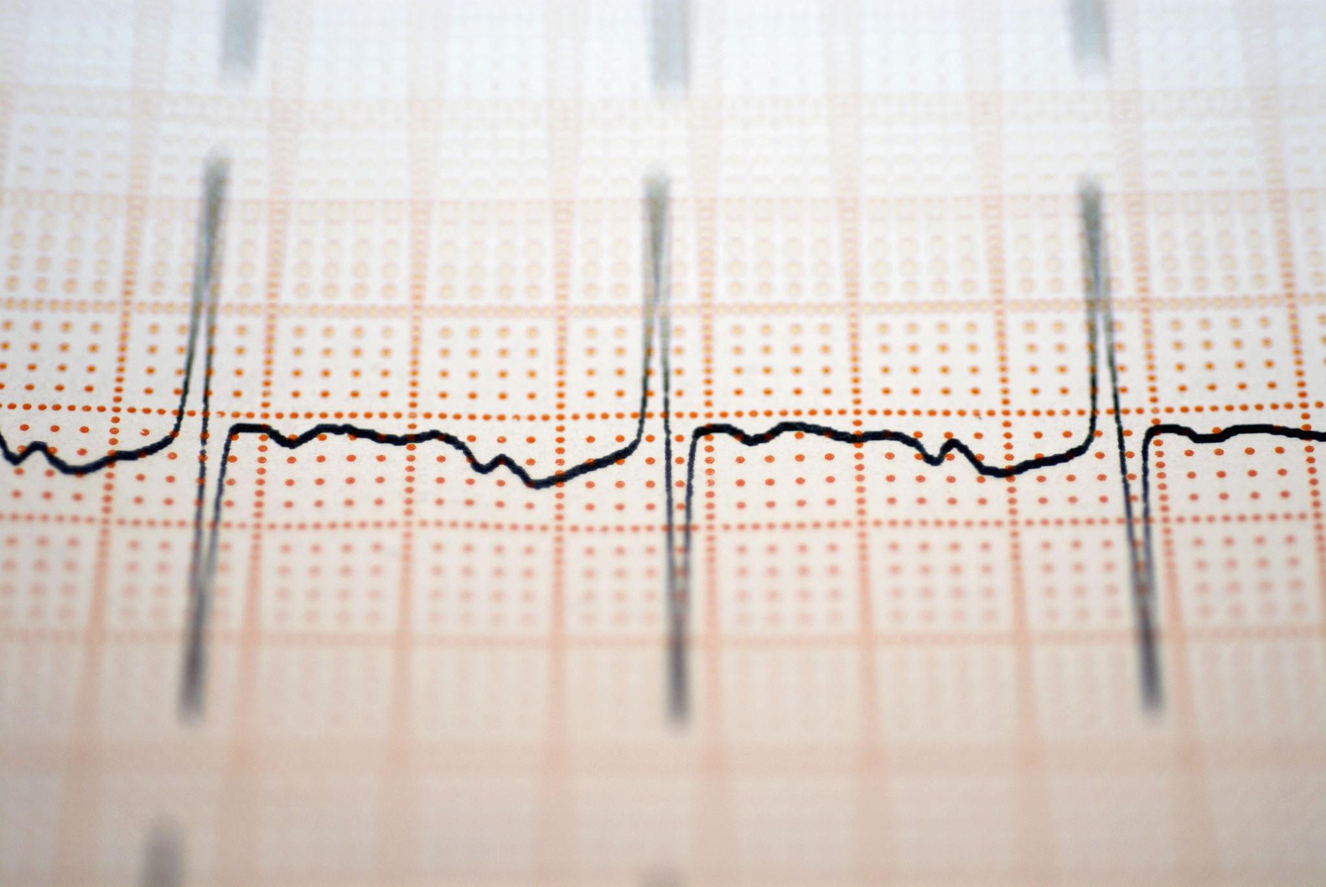
CARDIOLOGY

Slide 171
EKG COMPLEXES

Slide 172
https://litfl.com/normal-paediatric-ecg/
Pathophysiology
At birth, the right ventricle is larger and thicker than the left ventricle, reflecting greater physiological stresses placed upon it in utero (i.e. pumping blood through the relatively high-resistance pulmonary circulation).
This produces an ECG picture reflecting that of a right ventricular strain pattern in adults:
T-wave inversions in V1-3
Right axis deviation
Dominant R wave in V1
Conduction intervals (PR interval, QRS duration) are shorter than adults due to the smaller cardiac size.

Slide 173
https://litfl.com/normal-paediatric-ecg/
Heart rate > 100 beats/min
Apparent right ventricular strain pattern:
T wave inversions in V1-3 (“juvenile T-wave pattern”)
Right axis deviation
Dominant R wave in V1
RSR’ pattern in V1
Marked sinus arrhythmia
Short PR interval (< 120ms) and QRS duration (<80ms)
Slightly peaked P waves (< 3mm in height is normal if ≤ 6 months)
Slightly prolonged QTc (≤ 490ms in infants ≤ 6 months)
Q waves in the inferior and left precordial leads

Slide 174
https://litfl.com/normal-paediatric-ecg/
Heart rates are highest in neonates and infants and decrease with age:
Newborn: 110 – 150 bpm
2 years: 85 – 125 bpm
4 years: 75 – 115 bpm
> 6 years: 60 – 100 bpm
The right ventricular dominance of the neonate and infant is gradually replaced by left ventricular dominance so that by 3-4 years of age, the paediatric ECG largely resembles that of adults

Slide 175
https://litfl.com/normal-paediatric-ecg/
This ECG of a healthy 2-year old boy displays many of the typical features of the paediatric ECG:
Heart rate of 110 bpm (normal for age)
Juvenile T-wave pattern (T wave inversion in V1-3)
Dominant R waves in V1-3
RSR’ pattern (partial RBBB morphology) in V1

Slide 176
BRADYCARDIA
Varies with age. “defined as a heart rate that is slower than what is considered normal for a child’s age”
Address only symptomatic bradycardia.
Low blood pressure and shock
Poor tissue perfusion
Change in mental status
Symptomatic bradycardia and less than 60 in infants and small children: BEGIN CPR

Slide 177
BRADYCARDIA: GOAL IS PERFUSION
The primary goal of symptomatic bradycardia treatment is to make sure the heart is adequately pumping blood to the body (adequate perfusion).
Treatment is not necessarily aimed at increasing the heart rate. Treatment should continue until symptoms/signs resolve.
If the person stops having a pulse, move to the Cardiac Arrest Protocol.
Always consider the reversible causes of bradycardia in pediatrics and treat if possible.
Atropine in doses less than 0.1 mg may worsen bradycardia (paradoxical bradycardia).

Slide 178
RESPONSE TO BRADYCARDIA
SYMPTOMATIC BRADYCARDIA
CHECK HEART RATE | Confirm abnormally low heart rate or a significant rate drop from previous normal
PALS SURVEY | A: Airway B: Breathing (Check O₂ sats; administer O₂ as needed) C: Circulation (Check BP and rate; 12-lead ECG; IV/IO access) D: Disability (Check Neuro status) E: Exposure (Check for signs of trauma, burns, fractures, etc.)
CHECK FOR SIGNS/ SYMPTOMS | Are there symptoms of shock or acute change in mental status? Are there symptoms being caused by the bradycardia?
BRADYCARDIA SYMPTOMATIC AND SERIOUS | Do not delay CPR Epinephrine 0.01 mg/kg IO/IV–Can be given every 3-5 minutes Atropine 0.02 mg/kg IO/IV–Can be repeated once
DRUGS UNSUCCESSFUL | Consider transthoracic/transvenous pacing (preferably with sedation) especially if bradycardia is the result of a complete heart block or an abnormal sinus node function Seek expert consultation

Slide 179
DOSES AND DETAILS EPINEPHRINE IO/IV DOSE:
0.01 mg/kg, Repeat every 3-5 minutes
If IO/IV access is unavailable but endotracheal (ET) tube is in place, may give ET dose of 0.1mg/kg
ATROPINE IO/IV DOSE:
0.02 mg/kg, may repeat once
Minimum dose of 0.1 mg
Maximum single dose of 0.5 mg
IDENTIFY AND TREAT UNDERLYING CAUSE
Maintain patent airway and assist breathing if necessary
If hypoxemic, administer oxygen
Use cardiac monitor to identify rhythm
Monitor blood pressure and pulse oximetry
IO/IV access
Assess 12-Lead ECG
PERSISTENT
NO BRADYARRHYTHMIA CAUSING:
Hypotension?
Acutely altered mental status?
Signs of shock?
YES
CPR IF HR
<60/MIN
with poor perfusion despite oxygenation and ventilation
Monitor and observe
Consider specialist consultation
NO
Bradycardia persists?
YES
Epinephrine
Atropine for increased vagal tone or primary AV block
Consider transthoracic pacing/transvenous pacing
Treat underlying causes
Figure 13
If pulseless arrest develops, go to Pediatric Cardiac Arrest Algorithm

Slide 180
REVIEW QUESTIONS
You are treating a child with a toxin ingestion, resulting in bradycardia. Atropine is advised by poison control. Why is the minimum dose 0.1 mg IV?
a. Rebound tachycardia
b. May worsen bradycardia
c. Apnea
d. Cardiac arrest
What is the drug of choice in managing symptomatic bradycardia?
a. Adenosine
b. Epinephrine
c. Lidocaine
d. Dopamine
Your team is treating a child with symptomatic bradycardia. His heart rate is 22 bpm, and you are having difficulty obtaining blood pressure.
Epinephrine and atropine have had no effect. What would be the next most appropriate action?
a. Faster CPR
b. Transthoracic pacing
c. High dose epinephrine
d. Terminate resuscitation
ANSWERS
B A dose less than 0.1 mg may worsen the bradycardia. The maximum dose for a child is 0.5 mg.
B Epinephrine is a potent vasopressor and will also increase heart rate. The dose for bradycardia is 0.01 mg/kg IV or IO.
B Transthoracic pacing

Slide 181
TACHYCARDIA
“Tachycardia is defined as a heart rate greater than what is considered normal for a child’s age.”
End goal is (and always regardless of issue) adequate perfusion
Tachycardia prevents
Adequate filling of the ventricles due to shortened relaxation (filling time).
Diminished blood flow to the coronary arteries and less oxygen for the heart muscle.

Slide 182
TACHYCARDIA
Signs and symptoms of tachycardia
• Respiratory distress/failure
• Poor tissue perfusion (e.g. low urine output)
• Altered mental state
• Pulmonary edema/congestion
• Weak, rapid pulse

Slide 183
TACHYCARDIA
Sinus tachycardia
• Normal rhythm with fast rate
Likely non-dangerous
Commonly occurring during stress or fever
Supraventricular tachycardia
Rhythm starts above the ventricles
Atrial fibrillation
Causes irregularly irregular heart rhythm
Atrial flutter
Causes a sawtooth pattern on ECG
Ventricular tachycardia
Rhythm starts in the ventricles
What are the chances of seeing A-fib or A-flutter in kids?

Slide 184
https://litfl.com/common-paediatric-arrhyhtmias/
Supraventricular tachycardia (SVT)
SVT is common in adult and paediatric populations. A more in-depth overview of SVT, including in the adult patient, can be found here.
SVT is the most common dysrhythmia seen in the paediatric population, and comprises over 90% of paediatric dysrhythmias. Of children presenting with SVT:
Half will have no underlying heart disease
1⁄4 will have WPW
Almost 1⁄4 will have congenital heart disease

Slide 185
https://litfl.com/common-paediatric-arrhyhtmias/
Supraventricular tachycardia (SVT)
Characteristics in the paediatric population
Rapid, regular usually narrow (< 80 ms) complex tachycardia:
220 – 320 bpm in infants
150 – 250 bpm in older children
P wave is usually invisible, or if visible is abnormal in axis and may precede or follow the QRS complex (retrograde P waves)
90% are of the re-entrant type

Slide 186
https://litfl.com/common-paediatric-arrhyhtmias/
Clinical significance
SVT may be well tolerated in infants for 12-24 hours. Congestive heart failure later manifests with irritability, poor perfusion, pallor, poor feeding, and then rapid deterioration
Note that > 95% of wide complex tachycardias in paediatrics are not VT, but SVT with aberrancy:
SVT with BBB (in pre-existing congenital heart disease)
Accessory pathway re-entrant SVT
SVT at ~250 bpm (RSR’ pattern in V1 is a normal finding in children)

Slide 187
https://litfl.com/common-paediatric-arrhyhtmias/
The presence of AV block will interrupt any re-entrant tachycardia that involves the AV node; therefore adenosine (transiently blocks AV conduction) works well for these rhythms. Several atrial rhythms; atrial flutter, atrial fibrillation and sinoatrial node re-entry tachycardia are also considered subgroups of re-entrant SVT. These do not respond to adenosine but the transient slowing of the ventricular rate may unmask the atrial activity and therefore underlying cause of the SVT. A running rhythm strip is therefore imperative.

Slide 188
https://litfl.com/common-paediatric-arrhyhtmias/
Wolff-Parkinson-White Syndrome
WPW syndrome is characterized by the occurrence of SVT plus specific ECG findings in sinus rhythm. The characteristic pre-excitation is evidenced by a short PR interval and widened QRS with a slurred upstroke or delta wave.
It is caused by ventricular excitation occurring earlier via the accessory pathway than it would have occurred via the normal AV node alone. With the onset of SVT, conduction reverses (becomes V to A) in the accessory pathway as part of the circular rhythm.
In a small number of patients with WPW, accessory pathway conduction is A to V in SVT (and reversed to become V to A in the AV node). This results in an anomalous ventricular activation sequence and a wide complex QRS (> 120 msec) followed by retrograde P waves which may be difficult to differentiate from VT.

Slide 189
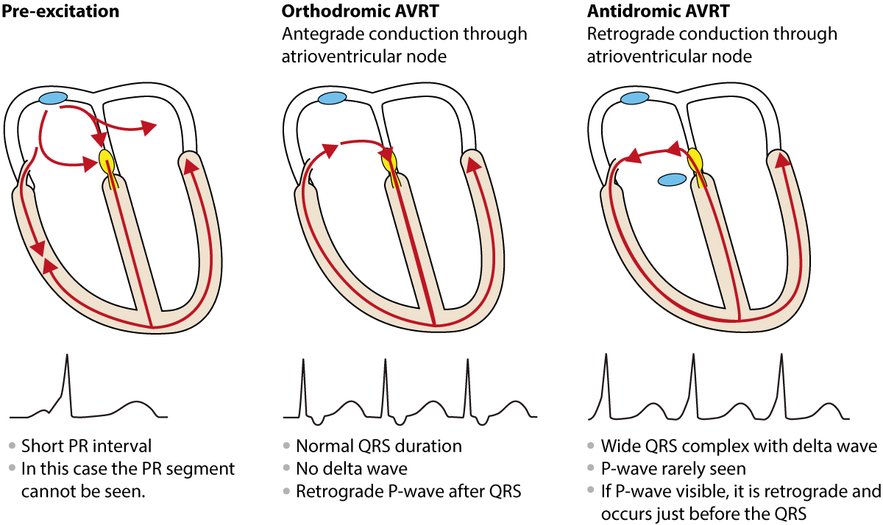
ORTHODROMIC VS ANTIDROMIC WPW
What is the difference between orthodromic and antidromic WPW treatment?
In orthodromic AVRT, an impulse leaves the SA node, travels normally through the AV node, and then back to the atria through the accessory pathway. In antidromic AVRT, the impulse travels from the SA node to the accessory path first, and then travels back to the atria via the AV node.

Slide 190
https://litfl.com/common-paediatric-arrhyhtmias/
Antidromic AVRT due to WPW in a 5-year old boy.
Broad complex tachycardia at ~280 bpm
This could easily be mistaken for VT; however, remember that >95% of broad complex tachycardias in paediatrics are actually SVT with aberrancy (usually a re-entrant tachycardia)
This is an antidromic atrioventricular re-entry tachycardia due to WPW

Slide 191
TACHYCARDIA
NARROW QRS COMPLEX (> 0.09 s) | WIDE QRS COMPLEX (> 0.09 s)
Atrial fibrillation or Atrial flutter | Ventricular tachycardia
Sinus tachycardia | Unusual SVT
Supraventricular Tachycardia (SVT)

Slide 192
NARROW COMPLEX TACHYCARDIAS
Sinus tachycardia and supraventricular tachycardias are most common forms of arrhythmias in children
SINUS TACHYCARDIA | SUPRAVENTRICULAR TACHYCARDIA
Infant: < 220 bpm | Infant: > 220 bpm
Child: < 180 bpm | Child: > 180 bpm
Slow onset | Abrupt start/stop
Fever, hypovolemia | Pulmonary edema
Varies with stimulation | Constant, fast rate
Visible P waves | Absent P waves

Slide 193
WIDE COMPLEX TACHYCARDIA
Ventricular tachycardia (VT) is uncommon in children but can be rapidly fatal.
An ECG with a QRS complex greater than 0.09 seconds is VT until proven otherwise.
Polymorphic VT,
Torsades de Pointes,
SVT with wide complexes due to aberrant conduction
VT may not be particularly rapid (simply greater than 120 bpm) but is regular.
Generally, P waves are lost during VT or become dissociated from the QRS complex.
Fusion beats are a sign of VT and are produced when both a supraventricular and ventricular impulse combine to produce a hybrid appearing QRS (fusion beat) (Figure 14).

Slide 194
I’m not sure it is V-Tach or SVT with aberrancy. What do I shock at?

Slide 195
Which of the following is not a life-threatening arrhythmia?
Torsades de Pointes
Ventricular fibrillation
Ventricular tachycardia
Sinus tachycardia
You are treating a 13-year-old male who has a history of congenital heart disease. The monitor shows a narrow complex rhythm with a heart rate of 175 bpm, and he has a palpable pulse. Which of the following is a possible diagnosis?
SVT with aberrancy
Sinus tachycardia
Torsades de Pointes
Ventricular tachycardia
You are treating a 10-year-old child who has SVT. What is the appropriate first dose for adenosine?
1 mg
6 mg
0.1 mg/kg with a maximum dose of 6 mg
12 mg
ANSWERS
1. D
Sinus tachycardia is often a response to an underlying condition such as fever, pain, or stress. Blood loss and hypovolemia can also result in sinus tachycardia, but the rhythm itself is not life-threatening.
2. B
Sinus tachycardia, atrial fibrillation or flutter, and supraventricular tachycardia are narrow complex rhythms.
3. C
Pediatric drug doses are based on weight. The maximum first dose is 6 mg for both adults and children.

Slide 196
CARDIAC ARREST
Cardiac arrest in pediatrics is TYPICALLY the consequence of respiratory failure or shock.
Need to focus on respiratory status and reversible causes
Less than 10% of the time cardiac arrest is caused by ventricular arrhythmia and occurs suddenly

Slide 197
CARDIAC ARREST: REVERSIBLE CAUSES
REVERSIBLECAUSES OF CARDIAC ARREST
THE H’S | THE T’S
Hypovolemia | Tension pneumothorax
Hypoxia | Tamponade
H+ (acidosis) | Toxins
Hypo/Hyperkalemia | Thrombosis (coronary)
Hypoglycemia | Thrombosis (pulmonary)
Hypothermia | Trauma (unrecognized)

Slide 198
CARDIAC ARREST: CARDIAC CAUSES
RECOGNIZE CARDIOPULMONARY FAILURE
AIRWAY | May or may not be patent
BREATHING | Slow breathing Ineffective breathing
CIRCULATION | Bradycardia and hypotension Slow capillary refill Weak central pulses (carotid) No peripheral pulses (radial) Skin mottling/cyanosis/ coolness
DISABILITY | Decreased level of consciousness
EXPOSURE | Bleeding? Hypothermia? Trauma?
RECOGNIZE ARREST RHYTHMS
ASYSTOLE
PULSELESS ELECTRICAL ACTIVITY (PEA)
VENTRICULAR FIBRILLATION (V FiB)
PULSELESS VENTRICULAR TACHYCARDIA (VTach)

Slide 199
RHYTHMS:PEA & ASYSTOLE
BOTH ARE UNSHOCKABLE AND LETHAL
Asystole: “flat line” may have small “squiggles” on the monitor
Pulseless Electrical Activity, PEA: A PULSELESS rhythm except VF, VT or asystole. May even present as sinus rhythm.
Agonal Rhythm: A waveform that looks similar to a normal waveform but occurs intermittently, slowly and NO PULSE.

Slide 200
RHYTHMS:VENTRICULAR FIBRILLATION & PULSELESS VENTRICULAR TACHYCARDIA
BOTH ARE SHOCKABLE RHYTHMS
Both result in ineffective ventricular contractions
Ventricular Fibrillation: Rapid quivering instead of forceful contractions.
Pulseless Ventricular Tachycardia: A rapidly contracting ventricle that is not pumping a sufficient amount of blood to maintain a blood pressure.

Slide 201
PALS CPR

Slide 202
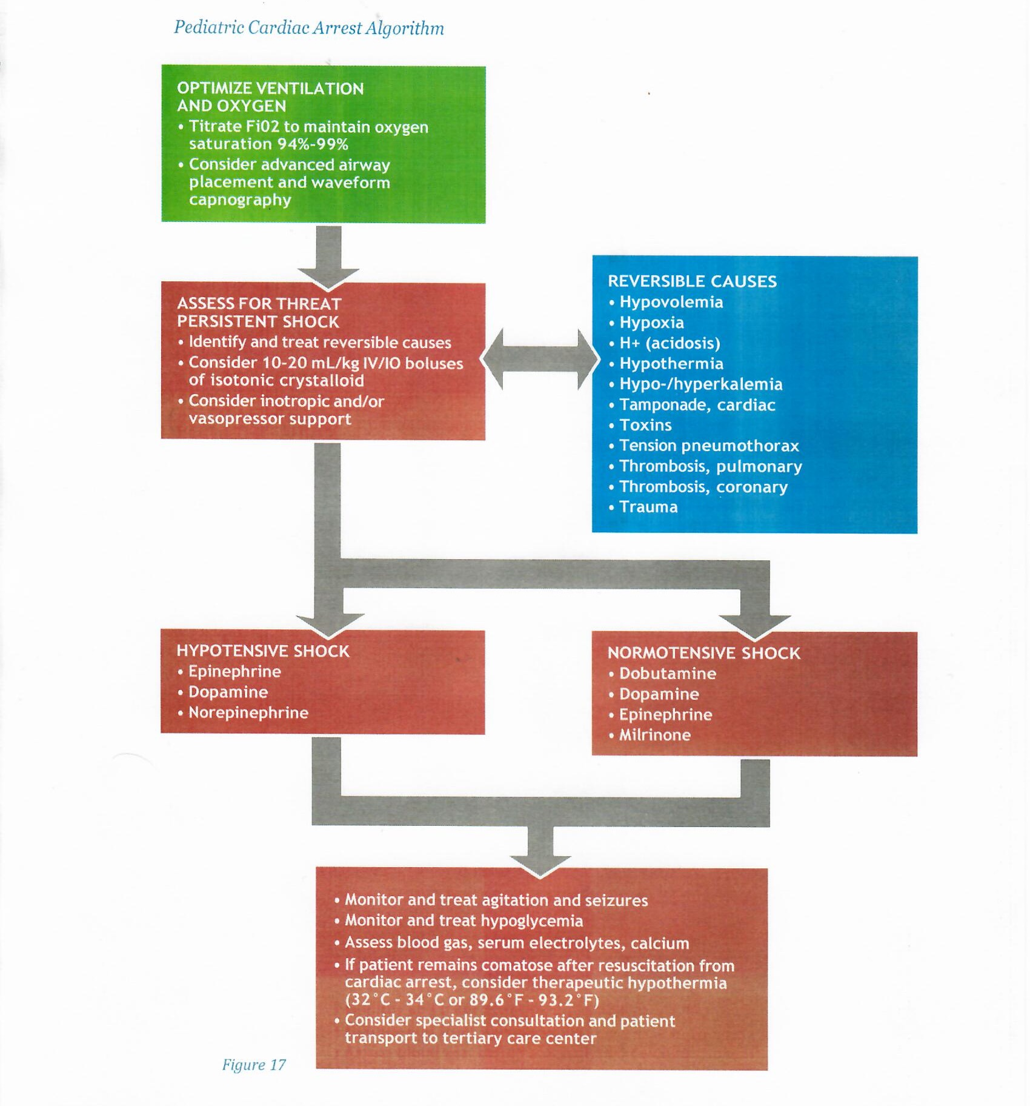

Slide 203
CPR Quality
Rate of 100 to 120 compressions per minute
Compression depth: one-third diameter of chest (1.5 inches (4 cm) in infants and 2 inches (5 cm) in children)
Minimize interruptions
Do not over ventilate
Rotate compressor every two minutes
If no advanced airway, 30:2 compression ventilation ratio for one provider and 15:2 compression ventilation ratio for two providers
If advanced airway, 10 to 15 breaths per minute for one provider or 20 to 30 breaths per minute for two providers with continuous chest compressions
Shock Energy
First shock: 2 J/kg
Second shock: 4 J/kg
Subsequent shocks: ³ 4 J/kg
Maximum dose of the shock: 10 J/kg or adult dose
Return of Spontaneous Circulation
Return of pulse and blood pressure
Spontaneous arterial pressure waves with intra-arterial monitoring

Slide 204
Advanced Airway
Supraglottic advanced airway or ET intubation
Waveform capnography to confirm and monitor ET tube placement
Once advanced airway in place, give one breath every 2 to 3 seconds (20 to 30 breaths per minute)
Drug Therapy
Epinephrine IV/IO dose: 0.01 mg/kg (Repeat every 3 to 5 minutes; if no IO/IV access, may give an endotracheal dose of 0.1 mg/kg.)
Amiodarone IV/IO dose: 5 mg/kg bolus during cardiac arrest (May repeat up to two times for refractory VF/pulseless VT.)
Reversible Causes
Hypovolemia
Hypoxia
H+ (acidosis)
Hypothermia
Hypo-/hyperkalemia
Hypoglycemia
Tamponade, cardiac
Toxins
Tension pneumothorax
Thrombosis, pulmonary
Thrombosis, coronary
Trauma

Slide 205
2019 American Heart Association Focused Update on Pediatric Advanced Life Support
Recommendation—Updated 2019 1.
BMV is reasonable compared with advanced airway interventions (endotracheal intubation or SGA) in the management of children during cardiac arrest in the out-of-hospital setting (Class 2a; Level of Evidence C-LD).

Slide 206
2019 American Heart Association Focused Update on Pediatric Advanced Life Support
20 MILLION DOLLAR QUESTION
Is BVM as good as ETT and/or SGA in OHCA?
OR
Do we suck at OHCA resuscitations?

Slide 207
Your team responds to a car accident where a 14-year-old is found in cardiac arrest. Which is a potentially reversible cause?
Aortic dissection
Traumatic brain injury
Tension pneumothorax
Spinal cord rupture
Which of the following are reversible causes of cardiac arrest?
Hyperthermia
Hypoxia
Tetanus
Theophylline overdose
ANSWERS
1. C
Remember the H’s & T’s when evaluating cardiac arrest individuals. A tension pneumothorax can be initially treated with needle decompression and subsequent chest tube placement.
The other injuries are not reversible.
2. B
Hypoxia is a common precipitating factor for pediatric cardiac arrest scenarios. Hypothermia, toxins, trauma, and tamponade are additional causes.

Slide 208
YOUTUBE PEDI CODES

Slide 209
https://www.youtube.com/watch?v=J3csLGObf-Y

Slide 210
https://www.youtube.com/watch?v=ohydtbrZmQc

Slide 211
https://www.youtube.com/watch?v=T-nc9vIqu4E

Slide 212
EKG COMPLEXES
YES
IS THE CHILD/INFANT RESPONSIVE?
NO
YES
IS THE CHILD/INFANT BREATHING EFFECTIVELY?
NO
DIAGNOSE AND TREAT
RESCUE BREATHING
YES
IS THERE AN ADEQUATE PULSE?
NO
START CPR
Figure 6

Slide 213
SHOCK

Slide 214
SHOCK
DEFINITION
Lack of oxygen and nutrients to peripheral tissues and end organs.
Typically associated with hypotension.

Slide 215
PRELOAD & AFTERLOAD
PRELOAD: Volume up to and including the ventricles.
Volume of blood and fluid
The amount the ventricle can accommodate.
AFTERLOAD: Resistance to pushing the fluid out of the ventricle.
Contractility
Vascular resistance

Slide 216
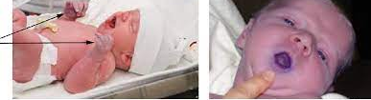
COMPENSATORY SHOCK
PERIPHERAL CYANOSIS
CENTRAL CYANOSIS
COMPENATORY SHOCK: INITIAL PHASE
HEART RATE: Increases to increase output.
BLOOD FLOW: Shunted away from less vital organs to vital organs.
Shunted from skin (bodies largest organ to internal organs; kidneys, brain
Central cyanosis
May have normal or near normal blood pressure

Slide 217
TYPES OF SHOCK
TYPES OF SHOCK
HYPOVOLEMIC | Low blood volume, often due to hemorrhage or fluid shifting out of vasculature
DISTRIBUTIVE | Blood vessel dilation (e.g. septic shock)
CARDIOGENIC | Heart is not pumping adequately
OBSTRUCTIVE | Physical block of the blood flow

Slide 218
HYPOVOLEMIC SHOCK
Most common type.
Insufficient blood flow
Blood loss: Trauma
“Fluid loss”: Diarrhea, vomiting, perspiration
Third spacing: goes into the tissue
Loss of preload: Less volume goes into the heart

Slide 219
DISTRIBUTIVE SHOCK
DISTRIBUTIVE SHOCK: Blood is inappropriately distributed in the vasculature.
Floppy heart: strength of contraction decreases
Dilated vessels: Resistance decreases and vessels dilate; venous and arterial

Slide 220
DISTRIBUTIVE SHOCK
SEPTIC SHOCK | ANAPHYLACTIC SHOCK | NEUROGENIC SHOCK
Decreased preload | Decreased preload | Decreased preload
Normal or decreased contractility | Contractility varies | Normal contractility
Afterload varies | Afterload is low in left ventricle and high in right ventricle | Afterload is decreased

Slide 221
DISTRIBUTIVE SHOCK
RESPIRATORY | RAPID | COMPENSATE FOR: Primary Hypoxia; pneumonia Acidosis: lack of perfusion to tissue
BLOOD PRESSURE | LOW | DECREASED CONTRACTILITY DILATED VESSELS
PULSE | RAPID/LOW | RAPID: CONPENSATORY LOW: “BEGINNING OF THE END”
CONSCIOUSNESS | DIMINISHED | LOW PERFUSION TO THE BRAIN

Slide 222
CARDIOGENIC SHOCK
FLOPPY HEART: Diminished contractility
WORK OF BREATHING:
Grunting
Nasal Flaring
Accessory Muscle Use
PULMONARY CONGESTION
CARDIAC CONDITIONS TYPICALLY CONGENITAL

Slide 223
OBSTRUCTIVE SHOCK
OBSTRUCTIVE SHOCK: HEART CAN’T BEAT PROPERLY.
Cardiac Tamponade.
Tension Pneumothorax.
Congenital Heart Malformations.
Pulmonary Embolism.

Slide 224
TREATMENT OF SHOCK
GOAL: PERFUSE THE BODY’S ORGANS
Increase Blood Pressure
Improve TISSUE oxygenation
Improve Cellular Efficiency
Reduce Acidosis

Slide 225
HYPOVOLEMIC SHOCK
Crystalloids: Normal Saline or Lactated Ringers
Volume Repletion: 20ml/kg
Blood Loss (hemorrhagic shock): 3 mL of fluid for every 1 mL of estimated blood loss
IMPORTANT TO MAKE ESTIMATES BASED ON SIZE OF CHILD AND ESTIMATED LOSS

Slide 226
DISTRIBUTIVE SHOCK
INITIAL MANAGEMENT: 20mL/kg of fluid over 5-10 minutes…….not an hour!
SEPTIC SHOCK:
Aggressive fluid management
Pressors
ANAPHYLACTIC SHOCK:
IM Epinephrine
Second Dose of Epinephrine
Cautious use of fluids
Benadryl and Steroids

Slide 227
DISTRIBUTIVE SHOCK
ANAPHYLACTIC SHOCK:
IM Epinephrine
Second Dose of Epinephrine
Cautious use of fluids
Benadryl and Steroids
Epinephrine Drip

Slide 228
DISTRIBUTIVE SHOCK
NEUROGENIC SHOCK:
Caused by injury to autonomic pathways in the spinal cord
Typically with spinal cord fracture
Vessels can’t constrict and dilate
Heart Rate usually low
Fluid boluses followed by pressors

Slide 229
CARDIOGENIC SHOCK
THINK CONGENITAL
POOR CONTRACTILITY
Need to address the cause and symptoms
CHF: Diuretics, Vasodilators
Hypotension: Pressors

Slide 230
OBSTRUCTIVE SHOCK
ACLS
&
TREAT THE CAUSE

Slide 231
SHOCK MIMMICKERS
Drugs?
Endocrine?
?

Slide 232
A seven-year-old child is struck by a car and found to be hypotensive. What is the most likely cause of low blood pressure?
Anaphylactic shock
Hypovolemic shock
Cardiogenic shock
Obstructive shock
What type of shock results in bounding peripheral pulses and a wide pulse pressure?
Septic
Cardiogenic
Traumatic
Hemorrhagic
You are treating a pediatric person with low blood pressure. What amount of fluid is recommended for bolus therapy?
100 mL
1-liter
5 mL/kg
20 mL/kg
ANSWERS
1. B
Trauma is a leading cause of blood loss and hypovolemic shock.
2. A
Septic shock can result in a wide pulse pressure with low systemic resistance and normal or increased stroke volume.
3. D
Consider boluses of 20 mL/kg of isotonic crystalloid (normal saline or lactated ringers).

Slide 233
PEDI ARREST

Slide 234
BREWSTER: PEDI ARREST
BP54, FS7, CA7, BFD, BPD d/p to s/a for report of pediatric cardiac arrest.
Upon arrival 3-month-old male found lying supine on bed, presenting unresponsive to stimuli, pale/cyanotic skin, apneic and pulseless. Patient observed with mild bruising to the forehead, and small quantity dried blood to both mouth and on sheet near the head. Patient further noted for very mild mottling to the rear of the head and neck. Mother states patient was fed and last seen normal at approximately 04:00 She had been sleeping in bed with the patient and woke to find him in current condition. Mother denies known traumatic/medical event prior. Neg past medical history, and not on any meds.

Slide 235
BREWSTER: PEDI ARREST
Patient noted warm, without rigor mortis, and without actual lividity and only mild redness. CPR initiated. Patient carried outside to ambulance. Mechanical chest compressions maintained at appropriate rate, manual respiratory rate administered via bag valve mask at 15 L per minute 02. Four lead EKG and defibrillation pad secured; initial rhythm observed for asystole. IO and IV access attempted without success due to difficult vasculature. 3.5 ETT secured, confirmed by bilateral chest rise, lung sounds, in tube misting. Patient transported to Brockton Hospital ED. During transport, maintained CPR, with further attempts to gain IV access without success.

Slide 236
HOSPITAL
HPI Narrative:
3mo 8d no known PMHx presents in cardiac arrest. EMS provides hx, family is not present at time of resuscitation. EMS arrived 1150 on scene, found baby with what appeared to be lividity to R forehead, cool, unresponsive. CPR initiated almost immediately (they estimate around 1152), intubated w/o difficulty. Pulse checks have all been asystole. Attempted IO but thinks infiltrated so have only been doing CPR, no meds have been administered. Per EMS, pt last seen normal at 0400 for a feed, had been sleeping in bed w mom. Mom woke up and found baby unresponsive. EMS reports some emesis on baby and on mom's chest, blood coming from nose and mouth and on mom's chest.

Slide 237
HOSPITAL
General: purple discoloration/lividity to R side of face and R temple, CPR in progress. extremely pale
HEENT: Head is normocephalic. Eyes with normal appearance, pupils mid range nonreactive. No myosis or mydriasis. Intubated, crusting blood in nares, scant blood from mouth.
Neck normal inspection and trachea midline.
Pulm: equal bs bilat, equal chest rise, no bs over epigastrium.
CV: CPR in progress. pallor. lividity/purple discoloration to L hand.
Abd: Abdominal exam soft, nondistended
Extremities: Normal appearance without calf tenderness or edema. IO to R shin, not functioning.
Back: Normal inspection
Neuro/psych: unresponsive
Skin: Pt not cool or cold, but temp feels lower than normal by palpation, dry and intact. No rash.

Slide 238
HOSPITAL
Medical decision-making narrative:
Approx 3mo M no known pmhx presents in cardiac arrest. Last seen at approx 0530 am after eating w mom in bed. Mom awoke with baby unresponsive on chest, with blood/emesis from nose/mouth. EMS initiated CPR, all rhythms asystole. Intubated in field and being ventilated. Unable to obtain IV access, no epi given prehosp.
On arrival to ER good qual CPR continued and pt bagged. IO access attempted multiple times w/o success. Epi given via ETT and D50 empirically. Ultimately 2 doses epi given and pulse checks w asystole. With CPR, bleeding from nose and mouth noted and face, hands becoming purple. Given last known normal, appearance/exam of patient (lividity on arrival), lack of rhythm (aystole), and no improvement despite CPR and ventilation, as well as epi, continuing CPR/ACLS is futile, no chance of meaningful recovery. Code called at 1225. Counseled dad after arrival and grandma over the phone (at dad's request).

